Slide 1
Unpacking the Common Core
Welcome! If you have difficulty launching, you may have to update java runtime (java.com).
To configure your computer, go to TOOLS, choose AUDIO→Audio set up wizard & follow screen instructions to set up speakers.

Slide 2
Unpacking the Common Core
Bridging the Divide Between Career & College Readiness

Slide 3
What is Black and White & Still Read All Over?

Slide 4
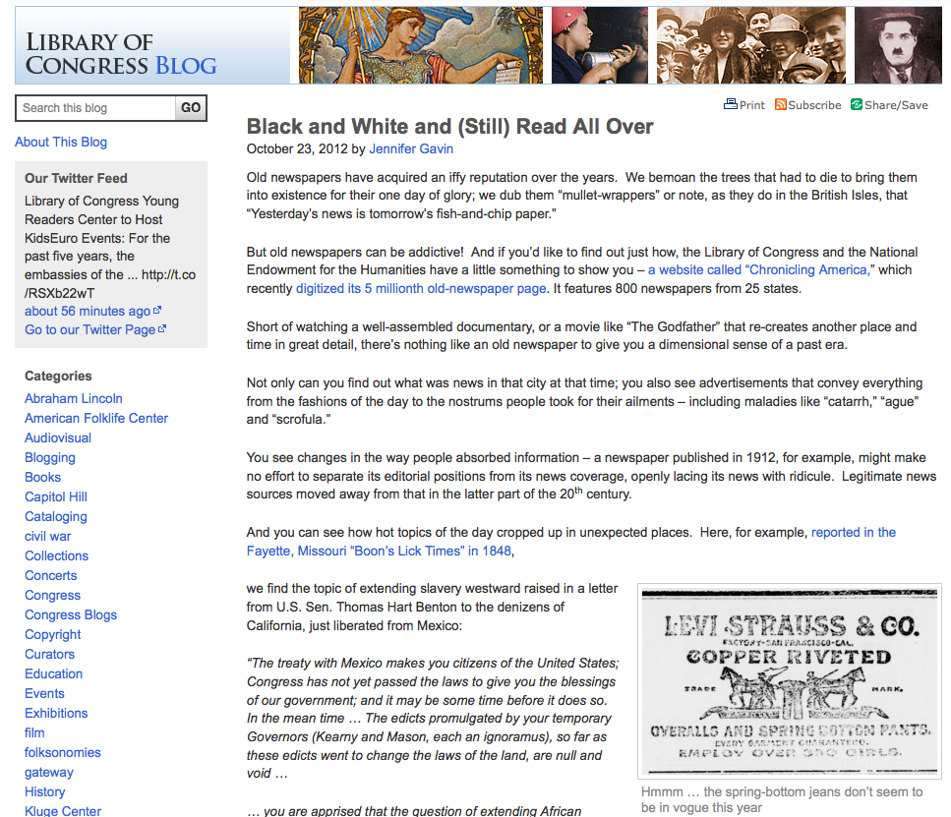
What is Black and White & Still Read All Over?
http://blogs.loc.gov/loc/2012/10/black-and-white-and-still-read-all-over/

Slide 5
Common Core
Standards for literacy and mathematics
This session: unpacking Common Core Reading Standards for Informational Text

Slide 6
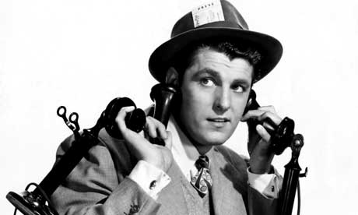
“Read like a detective, write like a reporter.”

Slide 7
Newspaper in Education (NIE)
The Tampa Bay Times NIE program is a cooperative effort between schools and the Times to promote the use of newspapers in print and electronic form as educational resources.
The goal of NIE is to build future, life-long readers, productive citizens and critical thinkers.

Slide 8
Times NIE services
The Tampa Bay Times Newspaper in Education program provides free resources to Citrus, Hernando, Hillsborough, Manatee, Pasco and Pinellas counties.
The TBT NIE provides more than 5-million newspapers, electronic licenses and curriculum guides to classrooms around Tampa Bay each year
TBT NIE hosts teacher workshops
TBT NIE provides teachers with free lesson plans in print and online – www.tampabay.com/nie.

Slide 9
Developing daily habits
Using the newspaper in your classroom and NIE curriculum on a regular basis helps students develop daily reading habits that they will carry through their lives.
The Times provides a vital link to the real world for students who too often do not realize the value of their academic programs. The study of today's critical issues, events and people helps students understand the past and see a role for themselves in their future world.

Slide 10
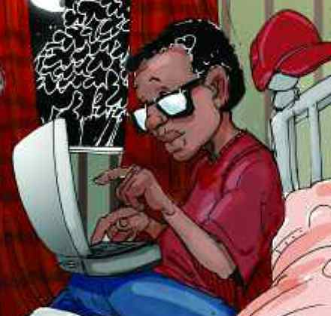
Engaging Readers
Combining the use of print newspapers and technology in the classroom will engage your struggling readers, bored underachievers or IB/advanced students.
(We know certain classrooms need to have the newsprint version, so we temporarily have a limited number of print copies available.)
Illustration from Bully Blaster serial Story, Hot Topics, Hot Serials
© 2006. All Rights Reserved

Slide 11
Cool features
You can access all seven editions in all counties.
E-Mail Articles to your friends or family.
Save or print the articles you want to keep.
Search for past articles.
E-mail notification for research and projects.

Slide 12
Access to the electronic edition
The access for the electronic edition is given to each media specialist.
Go to www.tampabay.com/nie
Click on Log in here
Enter school user name
Enter password (news)

Slide 13
Reading Anchor Standards 1-3: Key Ideas and Details Reading closely to find evidence, make inferences, and develop connections within the text
Read closely to determine what the text says explicitly and to make logical inferences from it; cite specific textual evidence when writing or speaking to support conclusions drawn from the text. Close reading, details, inference, read for purpose, ask and answer questions, quote from text.
Determine central ideas of themes of a text and analyze their development, summarize the key supporting details and ideas. Main Idea, details, examples, theme retell, summarize, theme (FFFL 3-5)
Analyze how and why individuals, events, and ideas develop and interact over the course of a text. connection between events, ideas, concepts, pieces of information, steps in a technical procedure (economic decision- making)

Slide 14
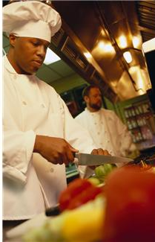
“Read like a detective, write like a reporter, & think like a . . ..”

Slide 15
CSI-R Model for Close Reading
Content: What content do you want to teach?
Standards/Skills/Strategies: What literacy standards, skills, or strategies will you use to teach the content?
Investigate: Immerse the students within a lesson where they investigate to find evidence to answer the question.
Report: Show what you know (write, podcast, blog, movie, etc.)

Slide 16
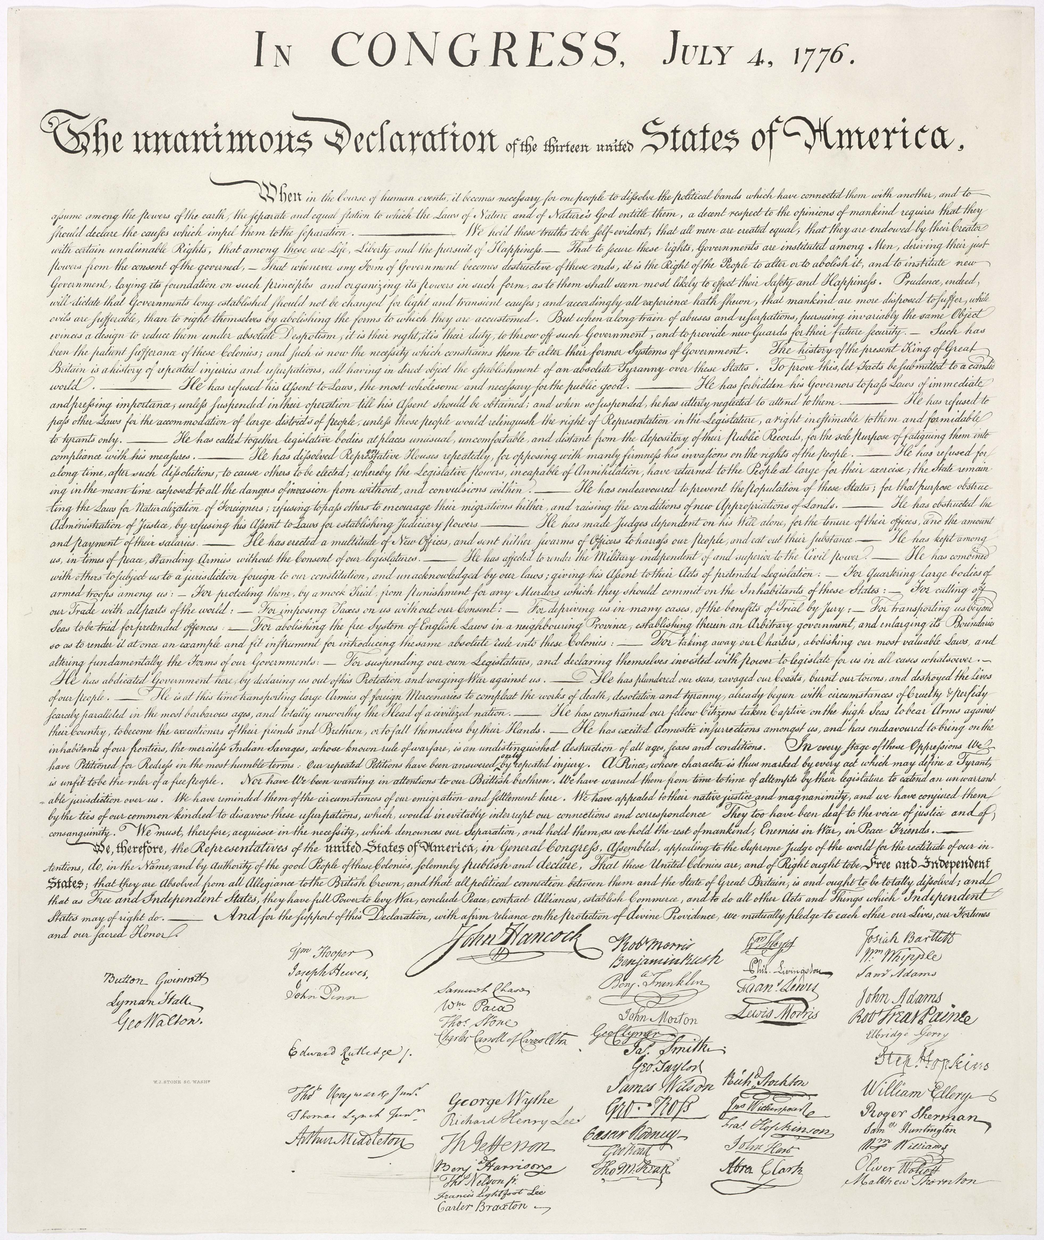
Which of the following questions require students to read the text closely?
If you were present at the signing of the Declaration of Independence, what would you do?
What are the reasons listed in the preamble for supporting their argument to separate from Great Britain?

Slide 17
Which of the following questions require students to read the text closely?
If you were present at the signing of the Declaration of Independence, what would you do?
What are the reasons listed in the preamble for supporting their argument to separate from Great Britain?

Slide 18
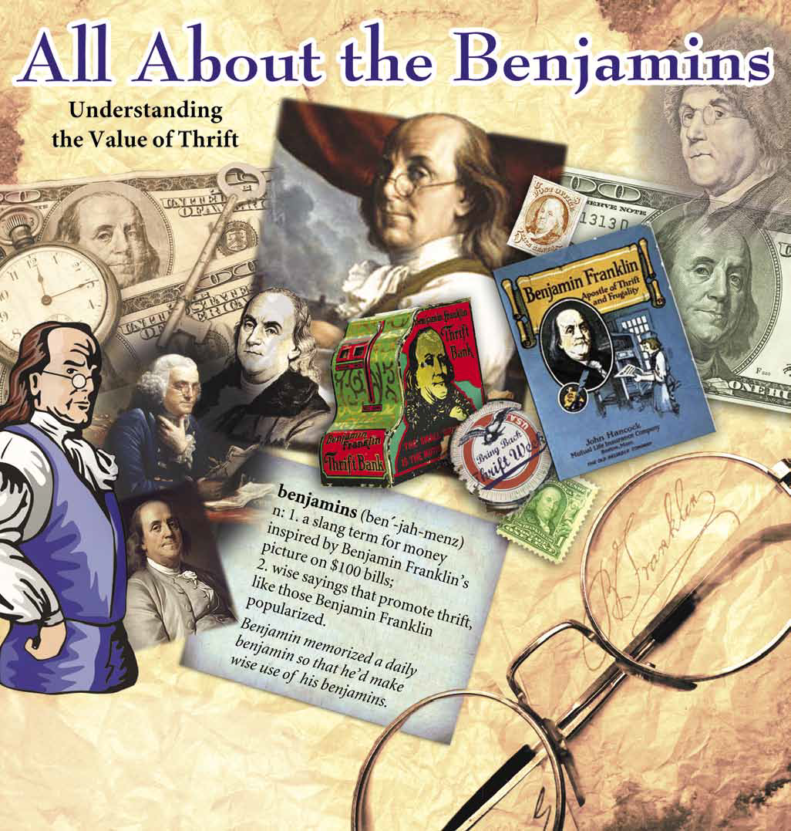
Close Reading
Establish a purpose for reading.
Ask students key questions about the text before reading.
They mark text during reading for evidence.
Evidence & Inference.
Discuss their evidence.
What are “Benjamins” and what do they have to do with thrift?

Slide 19
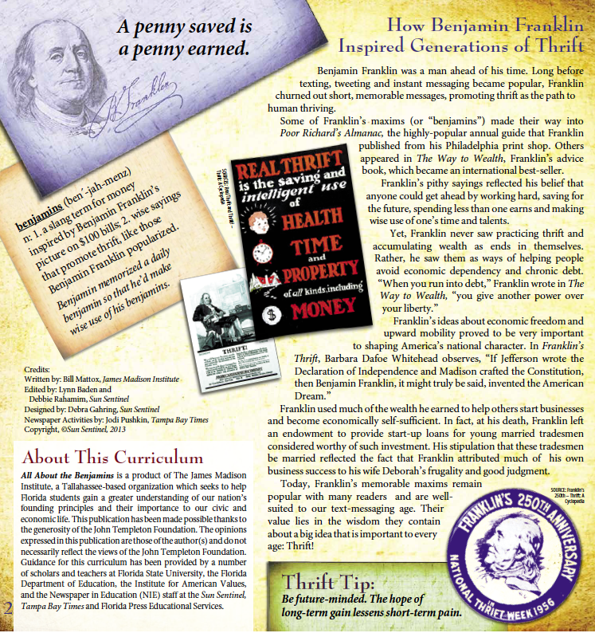
Close Reading
Establish a purpose for reading.
Ask students key questions about the text before reading.
They mark text during reading for evidence.
Evidence & Inference.
Discuss their evidence.
What are “Benjamins” and what do they have to do with thrift?

Slide 20
Main Ideas
Students read text for main idea and supporting details.
Retell
Summarize

Slide 21
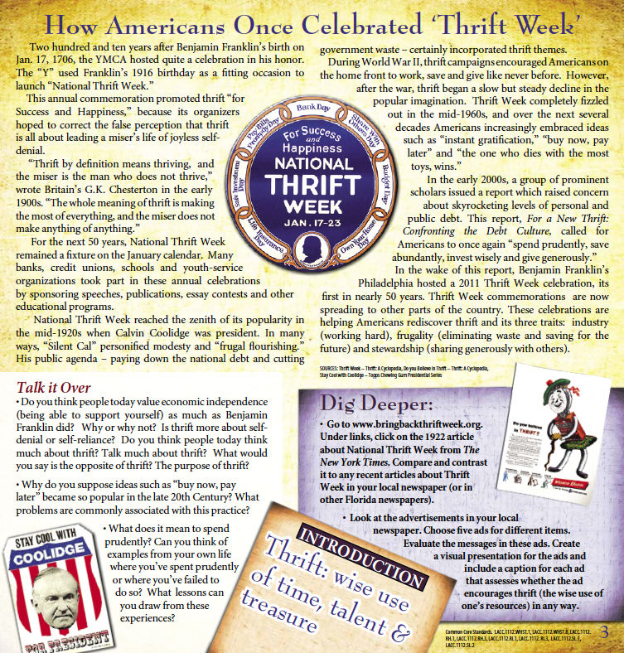
Connections & Interactions
Connection between finding this piece of information and other events
Historical sequence or timeline (history of National Thrift week)→
*

Slide 22
Reading Anchor Standards 4-6: Craft and Structure: Interpret the way the author: used words, chose text features, and illustrates purpose/bias
Interpret words and phrases as they are used in a text, including determining technical, connotative, & figurative meanings, and analyze how specific word choices shape meaning or tone.. Vocabulary and word meaning.
Analyze the structure of texts, including how specific sentences, paragraphs, and larger portions of the text (e.g., a section, chapter, scene, or stanza) relate to each other and the whole. text features, search tools, text structures (descriptive, sequence, compare/contrast, cause & effect, problem & solution)
Assess how point of view or author’s purpose shapes content & style of a text. Point of view and purpose, compare & Contrast accoutns of same event or topic

Slide 23
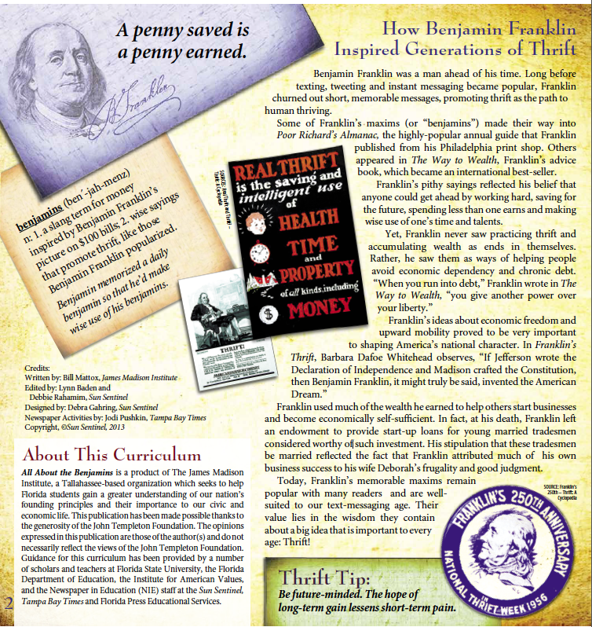
Vocabulary & Word Study
Article
Why did author use these words?
Benjamins
Read the text to discover what Benjamins are.
What other vocabulary do you see that can be investigated in context?

Slide 24
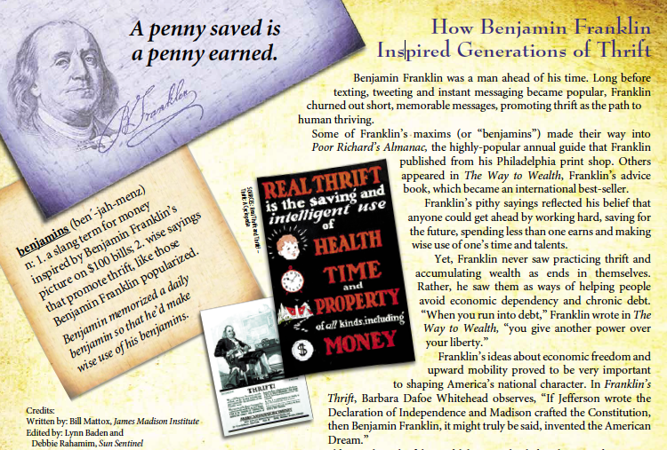

Slide 25
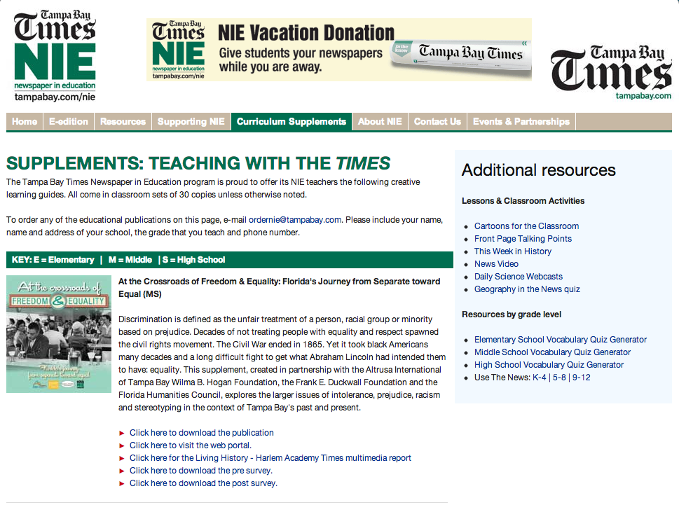
Structure/Features/Search
Title, author, source, context, date
Headings, menus, icons
Text features (hyperlinks, sidebars, arrows)
Structure (compare/contrast, descriptive, chronology, cause/effect, problem/solution)
Development of claims

Slide 26
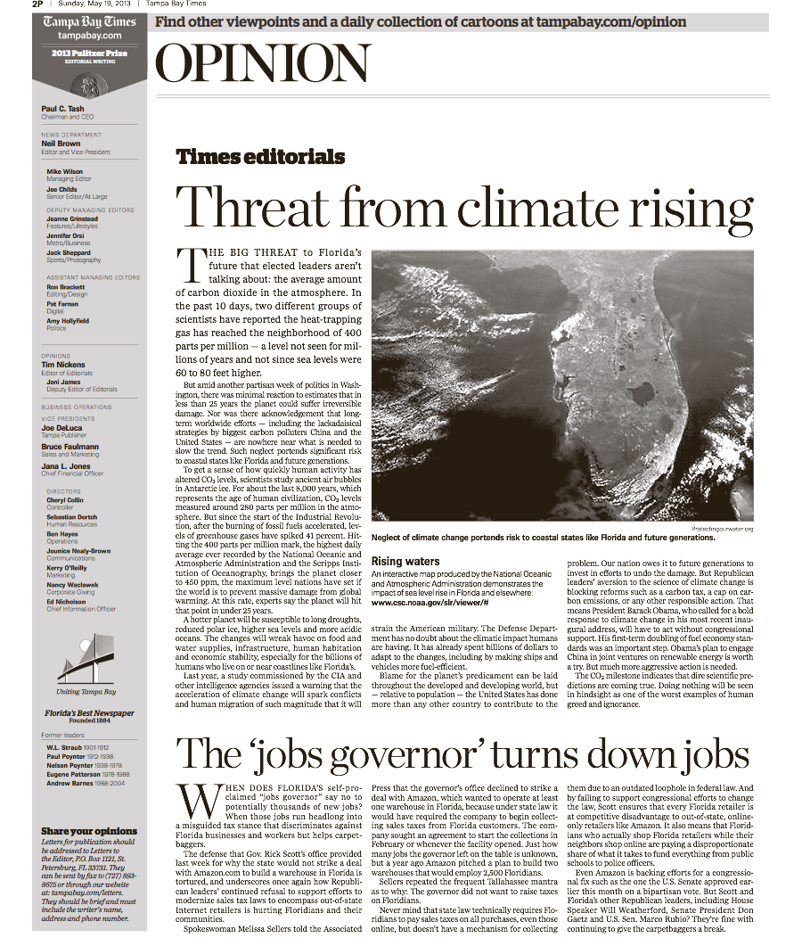
POV/Purpose
What is the source?
What is the author’s purpose of writing?
Compare with another account of the same finding.
What evidence does author present?
What persuasive tools does author use?

Slide 27
Reading Anchor Standards 7-9: Integration of Knowledge & Ideas: Gather and compare across texts, evaluate sources, and analyze evidence.
Integrate and evaluate content presented in diverse formats and media, including visually and quantitatively, as well as in words. Relationship between illustrations and text. Information presented in visual, oral, quantitative formats.
Delineate and evaluate the argument and claims in a text, including the validity of the reasoning and the relevancy and sufficiency of the evidence. Author’s claims, reasons, evidence, source. & arguments
Analyze how two or more texts address similar themes or topics in order to build knowledge or to compare the approaches the authors take. Compare & Contrast texts

Slide 28
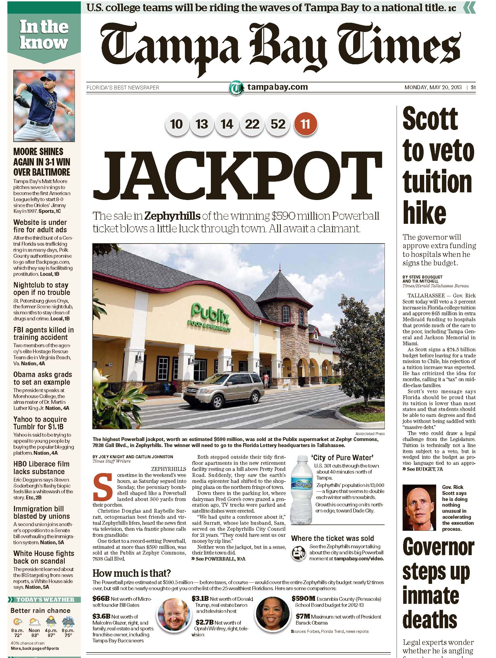
Multimedia
Tampa bay.com

Slide 29
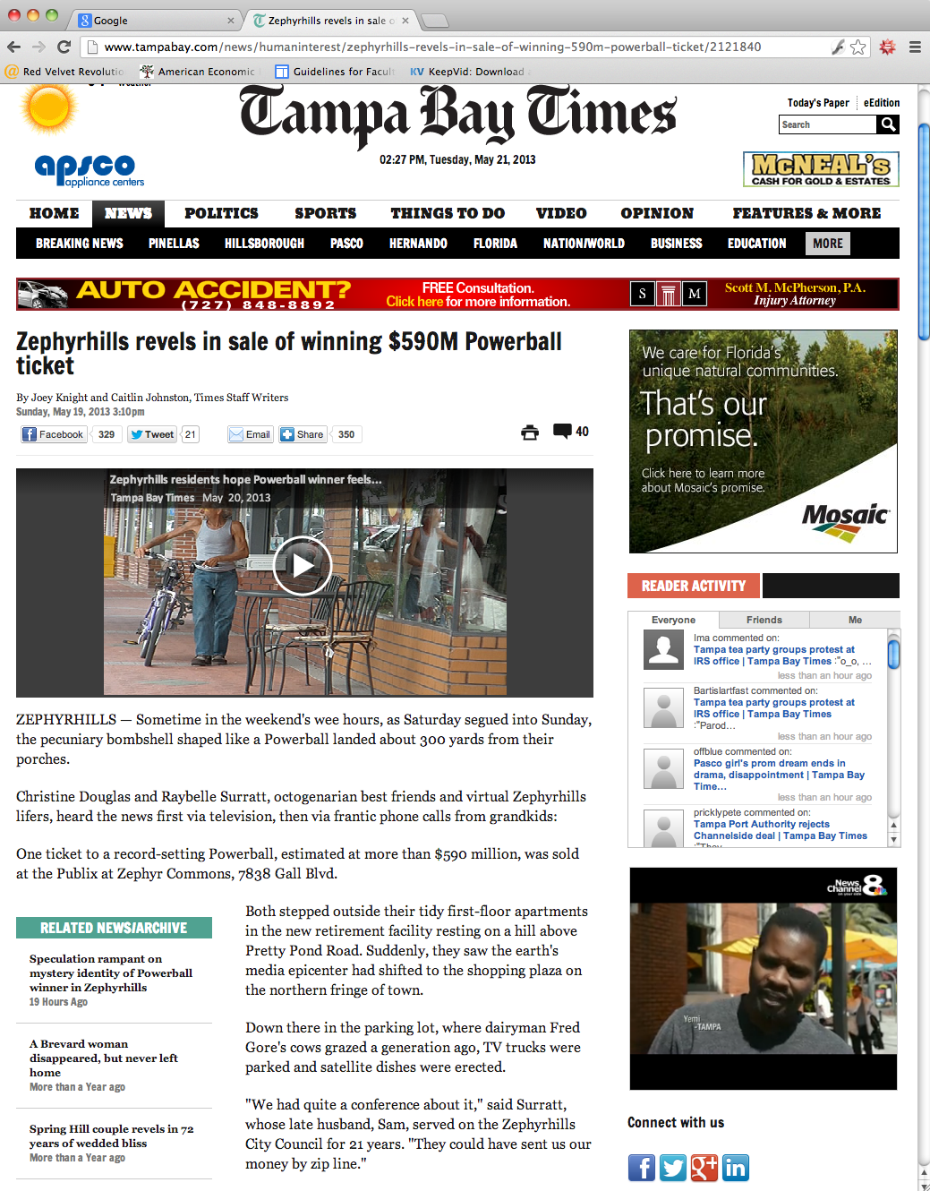
Multimedia
Tampa bay.com
Benjamins page with multiple

Slide 30
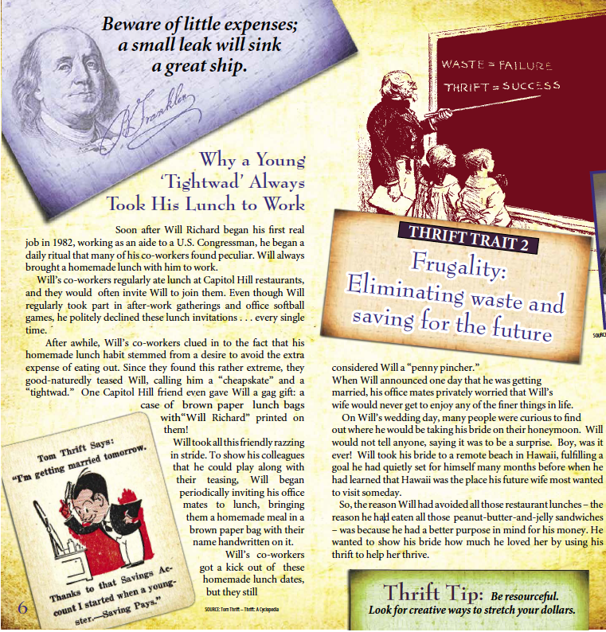
Evidence and Claims
What evidence does author provide explicitly about thrift?
What claims does author make implicitly?
Politifact

Slide 31
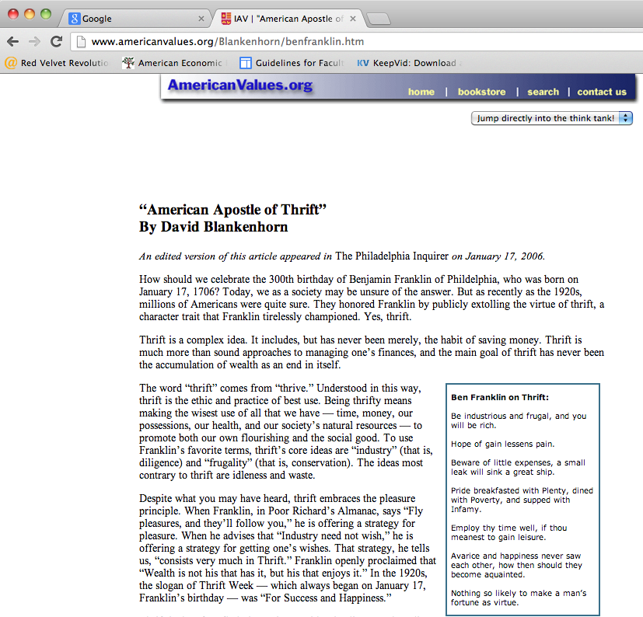
Corroboration

Slide 32
Other Texts About Benjamin Franklin
http://www.philadelphiafed.org/education/teachers/lesson-plans/benjamin-franklin.pdf lesson for the Benjamins and the Paper economy.
http://www.philadelphiafed.org/publications/economic-education/ben-franklin-and-paper-money-economy.pdf document
http://www.artyeaman.com/images/Lesson_Plan_LowerGrades_to_Accompany_BF_and_the_Birth_of_a_Paper_Money.PDF for grades 3-5
http://www.americanvalues.org/Blankenhorn/benfranklin.htm American apostle of thrift
http://www.benfranklin300.org/etc_article_entrepreneur.htm education and resources

Slide 33
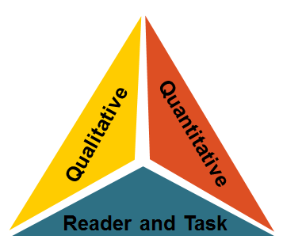
Range of reading and Level of text Complexity 10. Read and comprehend complex literary and informational texts independently and proficiently.
Students read the central, grade appropriate text (based on “lexiles” and other measures).
CCSS, Appendix A, page 4

Slide 34
Complex Texts

Slide 35
Thank You!
jpushkin@tampabay.com Jodi Pushkin: NIE
dkozdras@usf.edu Deborah Kozdras: Stavros
Website for NIE: tampabay.com/nie

