Slide 1
Behind the scenes of narrative journalism
How reporters build scenes and develop characters using records and more!

Slide 2

Standard process
Typically, we begin in person!
Something is happening!
And we write it down!
Notes:
Typically this is what that looks like!!

Slide 3
Capturing a sense of movement
In a hazy sea of tie-dye at Bayboro Brewing, the Deadheads bust out dance moves like you’ve never seen.
Women twirl in floor-length dresses. Someone near the stage performs standing crunches with jazz hands. Another guy flexes his fingers like he’s casting shadow puppets, or maybe a spell, on the musicians in front of him. Almost everyone seems to have a ponytail.
— Why does Tampa Bay have so many Grateful Dead cover bands?

Slide 4
Capturing a sense of place
From the second-story porch of the Palm Harbor Inn, Jennifer Spencer leaned back in a folding chair and watched as her 5-year-old granddaughter plunged a wood chip into a sun-dried cockroach.
“Ellie!” Jennifer gasped. “Really?”
Crouched low on two bare, dirt-covered feet, Ellie dipped her nose toward the concrete.
Her brown curls hung loose in her face, but the kindergartner kept the focus of a surgeon. Here on the walkway outside Room 218, there were plenty of pesty patients to practice on.
— Across Tampa Bay, families cram into motels to avoid life on the street

Slide 5
The big five
He drives to a nondescript business park and unlocks a nondescript office that smells strongly of new carpet.
Ten sportily dressed, immaculately groomed men arrive, one only 16, the oldest few in their mid-20s. They play cornhole as electronic dance music blares through a Bluetooth speaker.
Liam sips sugar-free Red Bull, kills the lights and leads them in a Wim Hof breathing exercise of deep, rhythmic exhalations.
He stands under a blood-red logo splashed on the wall reading “300,” as in the epic film about hopelessly outnumbered warriors valiantly battling invaders. He talks about “milking the turf,” “re-knocks,” “question-based selling” and the “10 pillars of solar.”
— ‘Constant rejection,’ big rewards: Life as a door to door salesman

Slide 6
‘News you can feel’
“The kind of journalism we end up doing is shaped by the way we think about our mission. If we think that a vital part of our job is to uncover, describe and evoke the texture, tone and meaning — the warp and woof, as people say… then the crucial role of intimate journalism comes suddenly and inevitably to the fore… It is not “news you can use,” as the modern catchphrase goes, but “news you can feel.”
— Walt Harrington, Seeking the Extraordinary in the Ordinary
^ The best journalism is both!!!

Slide 7

So, what happens when we can’t be there as a witness?
… Or when a central source won’t talk?

Slide 8
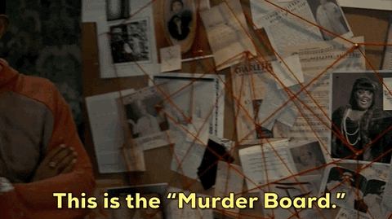
We turn to records and more: to flesh out characters, to recreate scenes

Slide 9
We treat reporting for details like an investigation!

Slide 10
First… we think about what might be accessible!
For each story, we make a list:
— What public records might exist?
— What private records might exist?
— Where can we visit (settings of action)?
— Who can we talk to?
— What does the internet remember?

Slide 11

We mix and match!
Many times, it’s the use of records in combination with one another that allow for a detail-rich sentence.

Slide 12
We stay organized
Creating one timeline where everything lives in chronology helps piece together patterns that we may have otherwise missed.

Slide 13
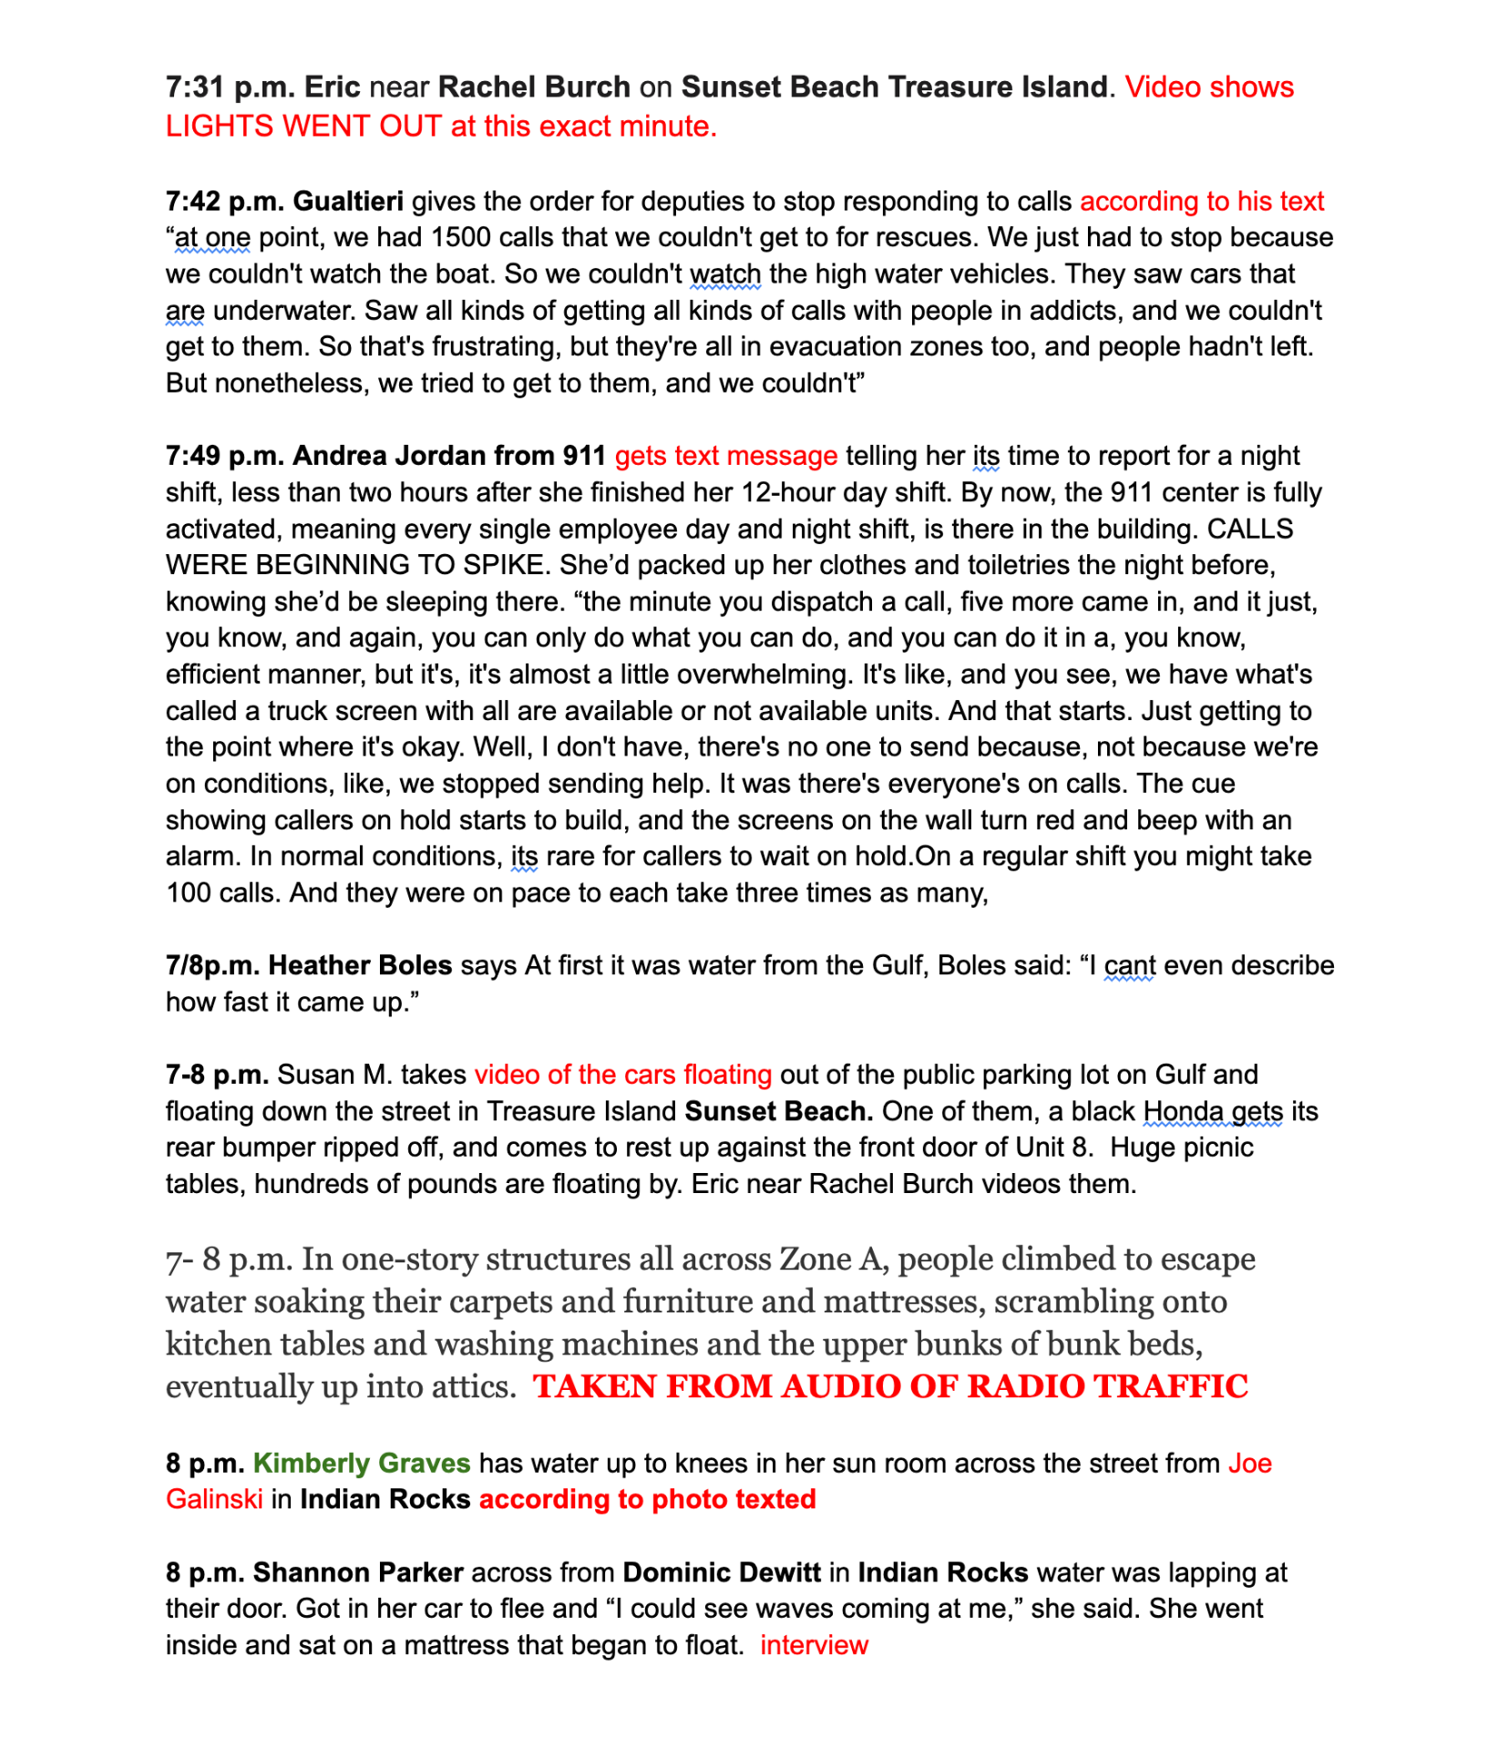

Slide 14
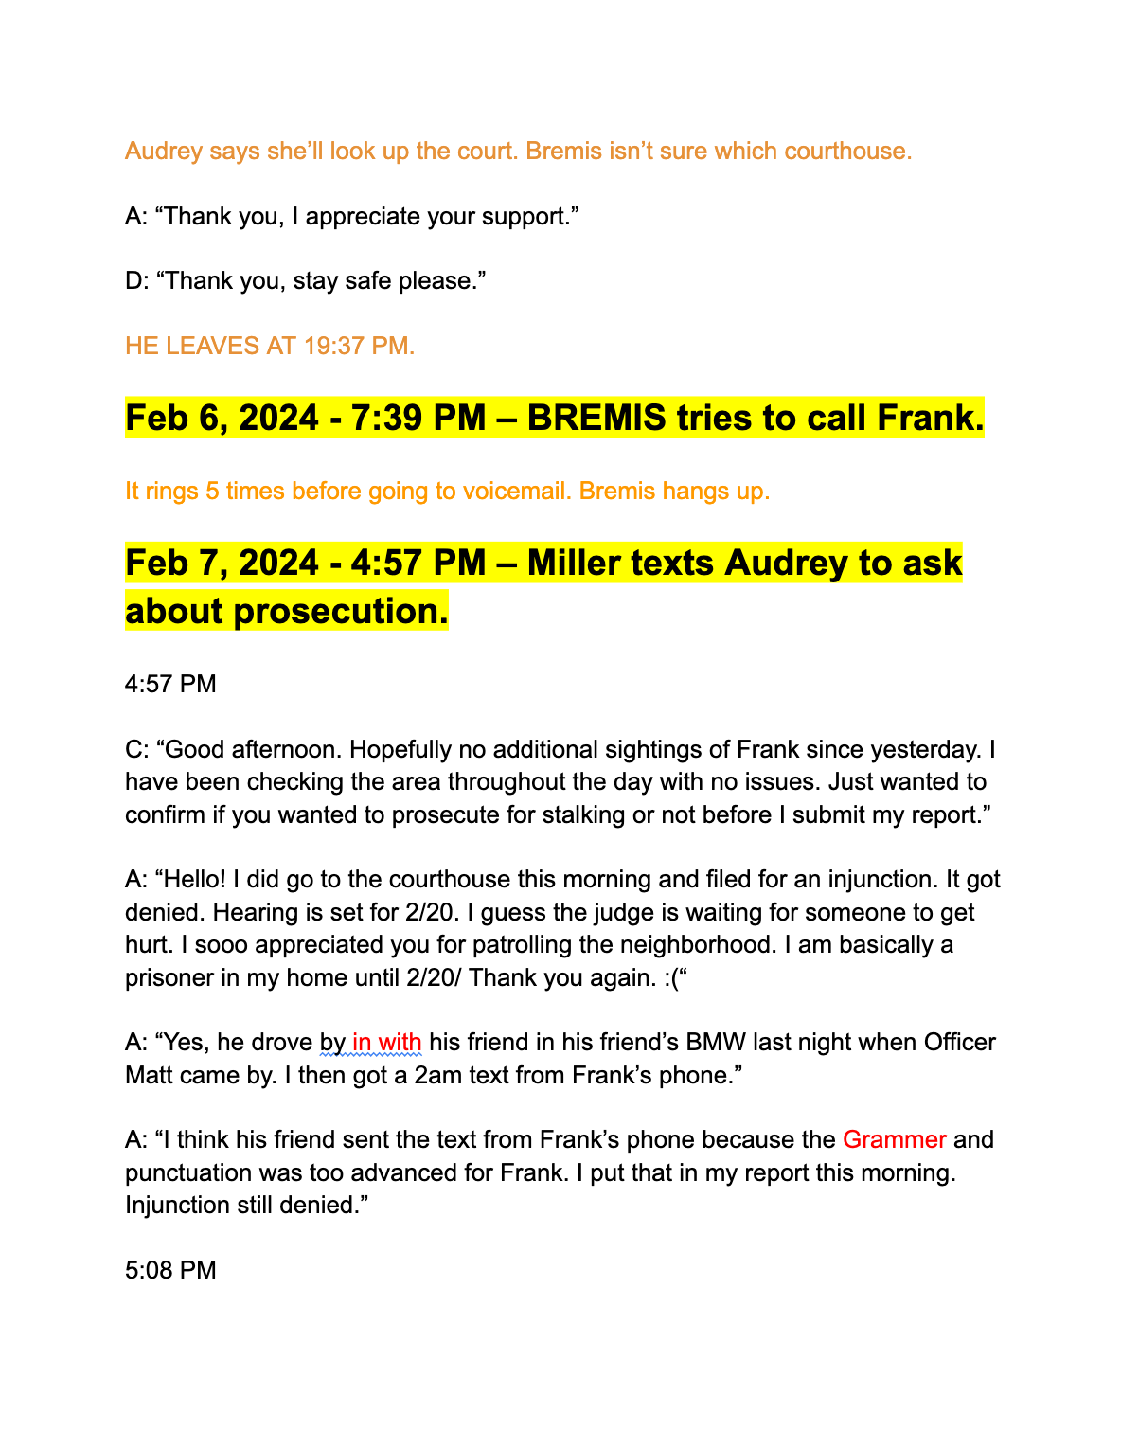

Slide 15
PUBLIC RECORDS

Slide 16
Public records
— 911 audio
— Body-worn camera footage
— Agency investigation reports + corresponding photos
— Personnel files
— Medical examiners notes
— Salaries
— Citations
— Voter registrations
— Property records
— Marriage and divorce records
— Court filings and transcripts

Slide 17
911 audio and body-worn camera footage
“I just got a text from him,” she told the operator, trembling. “My three daughters’ names are Kelly, Michelle and Jenn, and he said, ‘Kelly, Michelle and Jenn are going to miss you. Bye.’”
“I take that as a threat on my life,” she pleaded. Earlier, she explained, Scoza had pulled into her driveway and revved again.
She’d calmed down in the 30 minutes since, splashing water on her face to look presentable. But she wore worry like an article of clothing — her arms crossed, fingers rubbing the crook of her elbow. She’d been losing sleep, late to work twice in a row.
– A Florida nurse was stalked, then killed. Why didn’t police arrest her ex?

Slide 18
Medical Examiners reports
There was the 81-year-old man whose winter home was ruined, who was despondent over the loss of his belongings.
The 65-year-old man in Cape Coral who had struggled with mental illness most of his life, who had faced housing insecurity once before and was scared to do so again. He left a note making reference to the destruction of his home.
There was the 79-year-old staunch conservative who wore suspenders and a sun hat. He was a bookish man, described by one neighbor, who had a military background working with submarines. He had gotten rid of his insurance a few months earlier. Overwhelmed by Ian’s damage, he quickly sold his home for little money to “We Buy Ugly Houses,” but by November, he’d become distraught by the decision and unsure of where he would live.
Then, there was the 69-year-old retired nurse living on Pine Island. She was still grieving the husband she’d been with for 36 years, who had died the year prior. They’d moved from Michigan so he could live out his dream of boating on warm waters. After Ian hit, she confided in neighbors that she was frustrated with her insurance company, with whom she was fighting over her claim. She was depressed, she said, because of the piles of debris strewn around town now two months later.
Her body was found after she didn’t show up to family Thanksgiving.
– 6 people died by suicide in the aftermath of Hurricane Ian. Experts fear more.

Slide 19
Fleshing out a ‘no comment’ character
About a minute after she found him, Petersen lay at the step, taking gasping, gargled breaths.
Seconds later, Scoza lifted the gun to his head and pulled the trigger. [911 audio, police investigation timeline]
As sirens blared, officers circled. Bremis saw her first.
“Victim right here,” he panted. “Goddamn it.” [BWC Footage]

Slide 20
Continued:
He’d come from a day of traffic stops and accident injuries. Of conducting a welfare check and assisting another agency. [department work logs]
He touched Petersen’s neck. She was cold. [written report]
Several feet away, Scoza lay dead, but Bremis didn’t recognize him. He hadn’t met with him, not in person — no officer had. They’d only talked by phone. [BWC footage + police reports from week]
“Shit, dude.” Bremis’ voice wobbled. “I’ve been out here the past fucking week.”
He told another officer she’d applied for an injunction. “But it got fucking rejected.”
Days later, a police report arrived at the state attorney’s office recommending the state bring charges against a 71-year old Dunedin resident who had been stalking his ex-girlfriend. [SAO referral]

Slide 21
PRIVATE RECORDS

Slide 22
Private records
— Text messages
— Call logs
— Voicemails and memos
— Diary entries, sticky notes, etc.
— Family photos and videos
— Security footage/system logs
— Calendars
— Belongings

Slide 23
Diary entries
Five days later, on Sept. 3, NASA was ready to try launching Artemis I again.
Joey Vars, Paul Scribner and Michael Strittmatter woke up around 4 a.m. in St. Petersburg, packed the cooler and headed east.
It was quiet, and they saw the sun rise as they passed through Orlando. “This is Florida at its best,” Vars thought.
– Florida’s ‘real’ tourist attraction is rocket launches

Slide 24
Drafts/Written notes
He left a draft. It began, Clark R. Allen of Delray Beach, Florida, passed away on ____ __, _____ at the age of __. He’d moved last summer into assisted living, so his daughters changed the city to Lantana. They filled in July 22, 2021, and the age of 84. The rest of their dad’s draft obituary outlined the proper nouns of his life: the jobs and boards and schools. What about the guy who kept a spreadsheet of every family pet’s birthday? They needed to say something, too, about the way he died. What they had witnessed in Florida. Nicole emailed Danielle a furious start. Clark died of Covid. <insert info about being vaccinated but an unvaxed person killing him>
– In obituary for a vaccinated man, daughters share anger — and a plea

Slide 25
Writing from video
At 5:23 p.m., Chambers noticed the gulf water crashing over the beach dunes, which are taller than him. A big white van pulled up to Ka’tiki to evacuate the bartenders and staff. Within minutes the water was up to his knees on Gulf Boulevard as he fought his way back toward his apartment. The firecracker pops and crackles of damaged power lines sent him scrambling up the wooden steps of a random vacation rental up to a balcony. The two scared tourists staying in the room asked him, “Is this normal?” They let him stay.
At 7:31 p.m., all the power on Sunset Beach went out. All they could see were blinking lights from the car alarms honking everywhere. It was around this time that cars started floating.
In St. Pete Beach, Havard, the former Harley rider, had called her out-of-town son six times with hourly updates. At about 9 p.m., as the water rose above her feet, she sat on her bed to stay dry. “I’m going to be alright,” she told her son. “I’ll call you in the morning.”
At 10:30 p.m., Gualtieri surveyed the streets from a high-water vehicle at the corner of Bay Pines Boulevard and 100th Way N in Seminole. Cars stood dead in the intersection with water up to the windshields. “Are people still in those cars?” he wondered.
– Time ran out for Pinellas residents who didn’t evacuate for Helene

Slide 26
Writing from photos
Plumes of dust, laced with lead, blow across the factory like a sandstorm. The poison hangs so thick in the air, sometimes the only thing visible is the warm, orange glow from the furnace.
Workers, hundreds of them, sweat through 12-hour shifts at Gopher Resource in Tampa. They extract lead from used car batteries, melt it down and turn it into blocks of metal to resell.
– Poisoned, Part 1: The Factory

Slide 27


Slide 28
Coaching sources to deliver (before)
The message caught Ashley by surprise.
It came from a woman she hadn’t talked to in years — her husband’s former drug counselor, now his friend. The woman said she’d been visiting with Ashley’s husband. He missed her. Would Ashley go by the house, just talk with him?
In the 10 days since her world had crumbled, Ashley hadn’t gotten much sleep. Anxiety attacks kept her up as she wrestled with what was worse: her fear of her ex, or her fear of losing him. Bills were coming due, and she was falling behind. Leanna had taken out a $3,000 loan to help.
Her son had been asking where “da-da” was, and every time he did, those hazel eyes staring up at her, she wondered if her knees might crumble beneath her. She knew that it shouldn’t, but in those moments, the pain felt so much greater than absorbing his blows. She wanted to go back in time.
So it didn’t take much convincing for Ashley to gather her son and head toward the home.
– She left her abusive ex. Could she stay away?

Slide 29
Coaching sources to deliver (after)
The message caught Ashley by surprise.
It came from a woman she didn’t talk to often — her husband’s former drug counselor, now his friend. Because of the temporary injunction, Ashley’s husband couldn’t contact her. The woman said to give her a call.
“He can't stand being without you. He said he's going crazy,” the woman said. “Why are you letting your family run your life, Ashley?”
Ashley sniffled. Anxiety attacks had been keeping her up in the 10 days since she’d left. Bills were coming due. Leanna had taken out a $3,000 loan to help. Her son had been asking where “dada” was, those hazel eyes staring up at her.
Ashley knew that it shouldn’t, but in those moments, the pain felt so much greater than absorbing his blows. She wanted to go back in time, she said, unaware that he was there, listening in.
“I miss the life we had together,” Ashley said. “I don't want him back because of the financial support, I want him back because he is my love.”
If she wanted to come meet with him, the woman said, she’d be happy to arrange it — on one condition.
“You do not tell your family about this meeting,” she told Ashley. “I don’t want the cops showing up at my house.”
So Ashley left her phone behind as she stepped out with her son.
– She left her abusive ex. Could she stay away?

Slide 30
Coaching sources to deliver (getting inside)
On a typical day, Liam wakes in his Westshore apartment beneath an artwork titled “Farewell to Anger,” beside a bookshelf holding “No Excuses!” “Pitch Anything” and “Secrets of Closing the Sale,” within view of a dry-erase board reading “first house by June 2023,” “20 Etherium, 1 Bitcoin, 30 Solana,” and “capital, invest, repeat.”
– ‘Constant rejection,’ big rewards: Life as a door to door salesman

Slide 31
OTHER

Slide 32
Mostly… the internet
— Social media posts
— Past news clips
— School or athletics promotions
— Wedding registries
— Baby registries
— Obituaries
— GoFundMe Pages, Venmo activity

Slide 33
Facebook
Rod’s first mixtape, Hunger Games Vol. 1, was popular enough that people were recognizing him on the street, but music money didn’t pay the rent after graduation. He got a job at Krispy Kreme. A drive-thru customer asked, “Are you that Rod Wave guy?” He smiled sheepishly and shook his head no.
– How Rod Wave made it from St. Petersburg to music stardom

Slide 34
Facebook
There was the 81-year-old man whose winter home was ruined, who was despondent over the loss of his belongings.
The 65-year-old man in Cape Coral who had struggled with mental illness most of his life, who had faced housing insecurity once before and was scared to do so again. He left a note making reference to the destruction of his home.
There was the 79-year-old staunch conservative who wore suspenders and a sun hat. He was a bookish man, described by one neighbor, who had a military background working with submarines. He had gotten rid of his insurance a few months earlier. Overwhelmed by Ian’s damage, he quickly sold his home for little money to “We Buy Ugly Houses,” but by November, he’d become distraught by the decision and unsure of where he would live.
Then, there was the 69-year-old retired nurse living on Pine Island. She was still grieving the husband she’d been with for 36 years, who had died the year prior. They’d moved from Michigan so he could live out his dream of boating on warm waters. After Ian hit, she confided in neighbors that she was frustrated with her insurance company, with whom she was fighting over her claim. She was depressed, she said, because of the piles of debris strewn around town now two months later.
Her body was found after she didn’t show up to family Thanksgiving.
– 6 people died by suicide in the aftermath of Hurricane Ian. Experts fear more.

Slide 35
News clips and Instagram posts
So on the evening of Feb. 2, 2024, Clearwater police officer Matthew Bremis listened as Petersen described the Camaro, the messages, her mounting anxiety. “You took 20 years of my life,” Scoza had sent in a text riddled with typos. “I’m not done. Be careful.”
In two years on the force, Bremis had won accolades. As a new recruit, the former college linebacker garnered praise for calming a 10-year-old girl with autism running through traffic. In 2023, a community group named him the department’s “Officer of the Year.”

Slide 36
Scouting the scene
They filed into the county courtroom, that drably carpeted chamber where lives change every day. When Ashley saw her husband in orange, the blood rushed from her face. He was on a screen, videoing in from jail.
“He can’t see her, by the way,” the judge said, signaling to Ashley. “I just want her to know that … so she’s comfortable.”
– She left her abusive ex. Could she stay away?

Slide 37
The great big sleuth
Barbara Grams lived close to downtown, a 19-year-old with lots of friends. She worked a fast food job at the Tampa Bay Center mall, taking it seriously enough to report an employee for stealing from the register — though not so seriously that she didn’t slip free baked potatoes to her friends. Her boss noticed she hung out with “acid rocker types.” – This paragraph combines at least four different police records
Late that August, as the skylights darkened, Grams wound down a shift at the Hot Potato, spooning cheese sauce and turkey cubes onto steaming spuds. – We looked up what time sunset was on that date, looked at photos of the since-demolished mall to see the skylights, and through much digging found an old menu for the restaurant on newspapers.com
She clocked out past 9 p.m., after workers rolled down security cages and exited past the dormant carousel and the “Risky Business” movie poster with Tom Cruise peering over his Ray-Bans. – police records for the time/exit, old newspaper clips to see what movie was playing, history website for carousel date and photos
She stepped into the warm Tampa air, a thin braid swinging in her loose brown hair. She crossed the mall parking lot with the Buccaneers’ sombrero-shaped stadium at her back.– weather records / police report / google maps.
– The Marked Man

Slide 38
QUESTIONS?
Lauren Peace
EMAIL: Lpeace@TampaBay.Com

