Slide 1

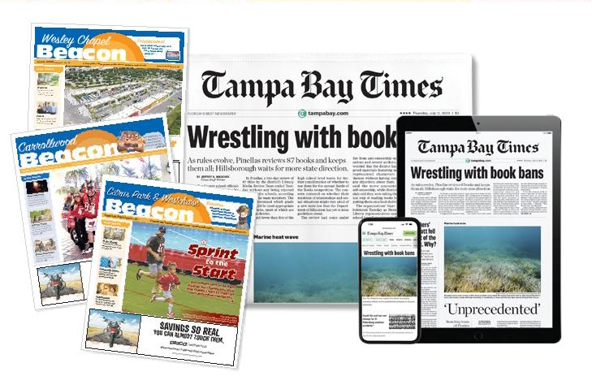

Slide 2

jpushkin@tampabay.com
Jodi Pushkin is manager and primary curriculum writer at the Tampa Bay Times Newspaper in Education program. She joined the Times in 2005.
She has been writing educational curriculum for NIE programs since 2000
Teacher since 1990
Currently adjunct professor at Saint Leo University and Hillsborough Community College

Slide 3

What is NIE?
NIE is a cooperative effort between schools and the newspaper to promote the use of newspapers in print and electronic form as educational resources. The goal of NIE is to build future, life-long readers of newspapers.

Slide 4

The Tampa Bay Times Newspaper in Education program provides free educational resources to Citrus, Hernando, Hillsborough, Manatee, Pasco, Pinellas and Polk counties thanks to our generous sponsors (grants, government organizations, individual donors).
Notes:
At the Times, we can provide free online access to any school in any county. For more information, email jpushkin@tampabay.com.

Slide 5
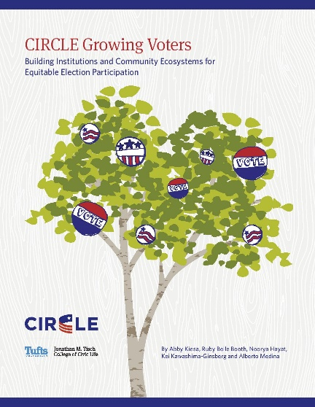
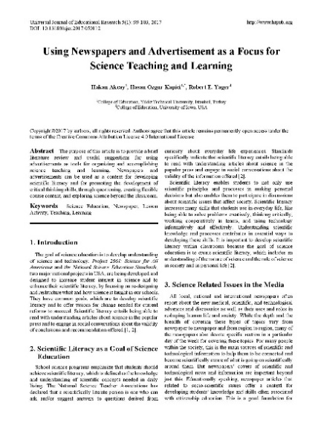
Research shows that students using the newspaper as an educational resource score more highly on standardized tests, develop the habit of lifelong reading and are more likely to become engaged citizens and regular voters.
Visit fpesnie.org and click on About/Research for more.

Slide 6
Developing daily habits
Using the newspaper in your classroom on a regular basis helps students develop daily reading habits that they will carry through their lives.
The newspaper provides a vital link to the real world for students who too often do not realize the value of their academic programs.
The study of today's critical issues, events and people helps students understand the past and see a role for themselves in their future world.

Slide 7
Newspapers are a cost-effective way to educate using primary and secondary sources.
Newspapers contain practical vocabulary and the best models of clear, concise writing.
Newspapers build vocabulary.
Newspapers improve reading skills.
Newspapers promote critical thinking.
Newspapers bring ideas and current events to life.
Newspapers build global awareness.
Newspapers promote social consciousness.

Slide 8
Newspapers as primary sources
“Working with primary sources builds a wide range of student skills, from reading complex texts to assessing the credibility of sources to conducting research.” - Library of Congress
Primary sources are the raw materials of history – original documents and objects that were created at the time under study.
Primary sources found in the newspaper include photographs, interviews – oral histories, eyewitness accounts, government documents and ads, audio recordings, political cartoons and maps.
Library of Congress – https://guides.loc.gov/student-resources/types#s-lib-ctab-25580069-0

Slide 9
Newspapers as secondary sources
From the Dictionary for Library and Information Science, "Any published or unpublished work that is one step removed from the original source, usually describing, summarizing, analyzing, evaluating, derived from, or based on primary source materials... also refers to material other than primary sources used in the preparation of a written work.“
Secondary sources are accounts that retell, analyze, or interpret events, usually at a distance of time or place.
Secondary sources found in the newspaper include reviews, critical analyses and second-person accounts .

Slide 10
Newspapers as informational text
Reading and interpreting informational text is a fundamental component of Florida’s B.E.S.T. Standards for English/Language Arts.
Informational text is nonfiction text whose primary purpose is to inform the reader about the natural or social world. Informational text employs a variety of structures to assist the reader in finding information quickly and efficiently.
Examples of informational text, other than articles, in the newspaper can include a table of contents, an index, bold or italicized text, glossaries for specialized vocabulary, embedded definitions for specialized vocabulary, realistic illustrations of photos, captions and other labels, and graphs and charts.

Slide 11

Informational text
The information within the pages of the newspaper can be primary and secondary sources. The information can be fact and opinion.
The term informational text includes various types of texts:
Essays
Articles
Letters
Images
Cartoons
Photographs
Advertisements

Slide 12



Read like a detective.
Write like a reporter.
Students need news literacy skills to use critical thinking skills to judge the reliability and credibility of news reports, whether they come via print, television, the internet or social media. Newspapers provide a great resource for determining fact vs. opinion.
Notes:
All people, especially young people, are inundated with information today. That is why it is important to introduce students to news literacy. Newspapers are great primary sources. Unlike other formats, such as social media and the internet, newspapers have vetted information that goes through checks and balances before it is published.

Slide 13
News Literacy is the ability
to use critical thinking skills to judge the reliability and credibility
of news reports, whether they come
via print, television, the internet or social media.

Slide 14
Media literacy
Common Sense Media defines media literacy as “the ability to identify different types of media and understand the messages they're sending.”
While there are a wide array of media sources, all media shares one thing: “Someone created it. And it was created for a reason. Understanding that reason is the basis of media literacy.”

Slide 15


Why newspapers
Newspapers are a critical tool for exploring all subject matters beyond the classroom and for developing literacy and critical thinking skills.
Newspapers provide a living textbook that updates and extends information contained in textbooks. Newspapers also demonstrate practical applications of skills and concepts presented in school curriculum by helping students relate school subjects to daily news relevant to their lives, happening right now in their state, community and neighborhood.

Slide 16

In-depth coverage
While students may think they have enough information, which they are getting from social media, that information is often surface level. The Tampa Bay Times provides the context, verification, and accountability reporting they won’t get elsewhere.

Slide 17
Informing the public
Local news covers the stuff that affects you students’ lives such as housing, jobs, transportation, and local events worth checking out.
Local news is a public good that keeps communities informed and connected. Like sidewalks and streetlights, local news is an essential resource for strong communities. It plays an important role in helping neighbors understand what’s happening and prepare to engage when it matters.
Local news is made by people who know what’s going on here because they’re part of it.
Local news matters. Unlike national outlets, here at the Times, we are accountable to the same community we serve. If we get something wrong, we correct it — and we face our neighbors. Trust is earned through consistent, accurate reporting close to home.

Slide 18
An essential skill
Media literacy is an essential skill in the digital age. Specifically, it helps kids:
Learn to think critically
Become a smart consumer of products and information
Recognize point of view
Create media responsibly
Identify the role of media in our culture
Understand the author's goal from you.

Slide 19
Reporters vs. journalists
While social media has lots of reporters, the definition of a professional journalist is more involved.
The Society of Professional Journalists notes, “Maintaining high ethical standards is essential to the practice of journalism, particularly in a climate of eroding public trust in the American press and the pervasive spread of misinformation.”
The Foreign Press Correspondents USA notes that “Journalists and media professionals have a set of rights, duties, obligations, and responsibilities that guide their work.”

Slide 20
Standards
According to the Foreign Press Correspondents USA, the most important duties of a journalist are as follows:
Accuracy and Truthfulness
Independence and Impartiality
Fairness and Objectivity
Integrity
Present a balanced view of events
Privacy and Sensitivity

Slide 21
A system of verification
Remember, once something is printed, it cannot be quickly edited as it can on social media or a blog, or even a television broadcast. Print media must go through a process that checks the veracity of sources and facts before going to press. That work begins with the reporter and ends with the copy desk.
A lot has changed at the Times over the past 140 years, but our mission remains the same. We are committed to local journalism. As one of the country’s few independent sources for news, our allegiance is to truth. The newsroom has no agenda; other than to serve our readers with a steady dose of important, relevant news.

Slide 22
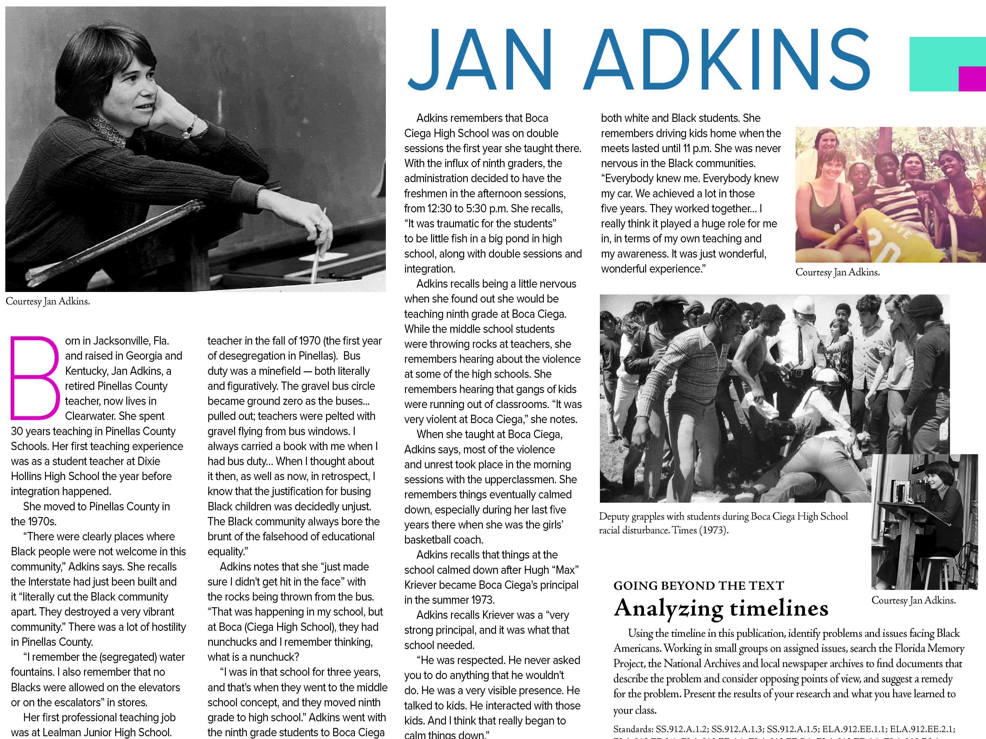

Slide 23
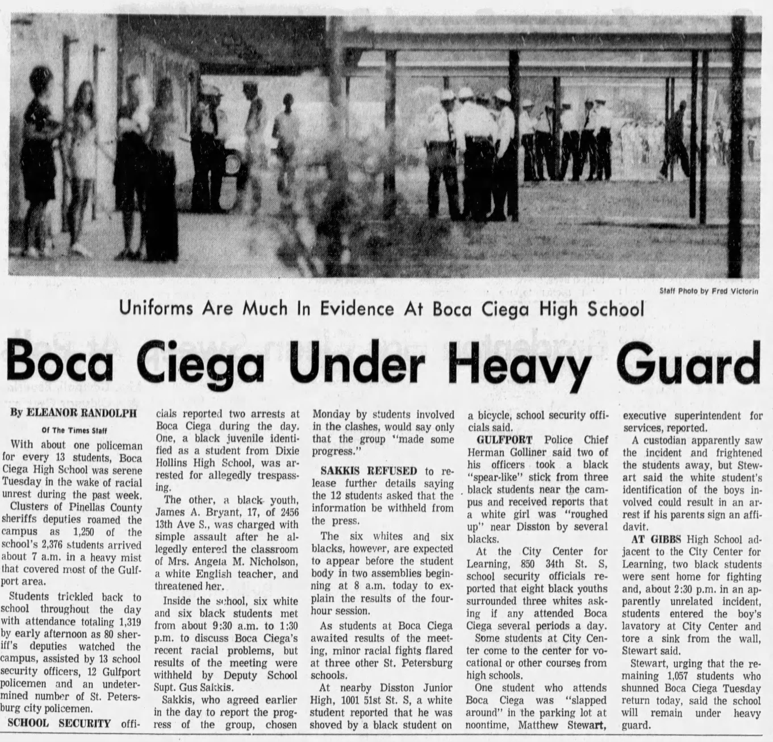

Slide 24
Information neighborhoods & rhetoric
 | Journalism | Entertainment | Promotion | Propaganda | Raw Information
Goal | To Inform | To Amuse or engage people during their leisure time in activities in which they are passive participants | To Sell goods, services and talent/personalities by increasing their appeal to others | To Build Mass Support for an ideology by canonizing its leaders or demonizing its opposition | To Bypass Institutional filters and distribution costs in order to sell, publicize, advocate, entertain and inform
Methods | Verification Independence Accountability | Story-telling, performance, the visual arts & music | Paid advertising & public relations activities. Press releases, public statements, staged events, sponsorships, product placement, websites, viral videos, etc. | One-sided accounts or outright lies, relying on emotional manipulation through images, appeals to majority values and fallacious reasoning | Facebook, YouTube, blogs, Twitter, websites, website comment sites, chain email, text message forwarding, flyers, graffiti
Practitioners | Reporters, photographers, videographers, editors News producers/publishers | Actors, Musicians, Writers, Producers, Comedians | Ad agencies, Publicists, Public Relation experts, government spokespersons | Political operatives and organizations | Anyone with a web connection, photocopier or can of paint
Outcome | Empowers citizens by educating them | Distraction from or changed view of daily life. Reinforcement or critique of social norms | Increased sales or products or services or higher fees from talent being promoted | Help an ideological group seize or maintain power by influencing public opinion and motivating the public to take action consistent with the ideology | Outlet for self-expression, entertainment, promotion, advocacy, propaganda
Source: Center for News Literacy, Stony Brook University School of Journalism

Slide 25
American Press Institute: Critical questions for interpreting media
Type: What kind of content is this?
Source: Who and what are the sources cited and why should I believe them?
Evidence: What’s the evidence and how was it vetted?
Interpretation: Is the main point of the piece proven by the evidence?
Completeness: What’s missing?
Knowledge: Am I learning every day what I need?

Slide 26
Key Questions to Ask:
Who made the message?
Who is the target audience (how do you know)?
Who paid for this? Or who gets paid if you read or respond to this message?
Who might benefit or be harmed by this?
What important info is left out or missing?
Is this credible (and what makes you think so)?
Is the main point proven by verifiable evidence?

Slide 27
Components of a news article
Who?
What?
Where?
When?
Why?
How?

Slide 28
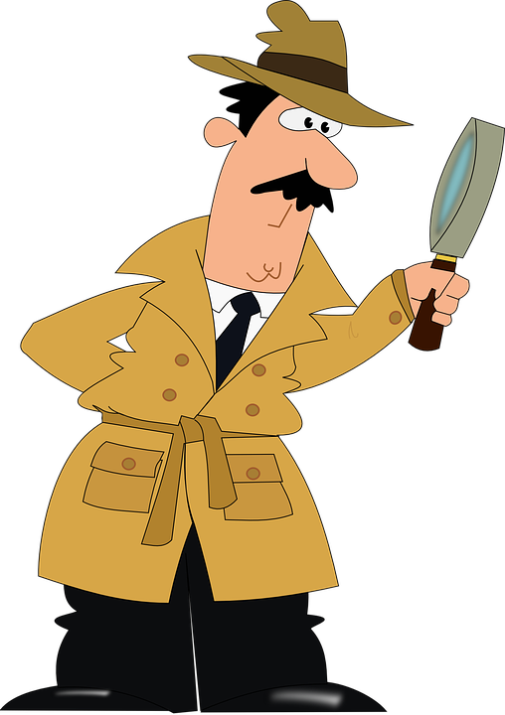
Consumers of media need to be news detectives…

Slide 29
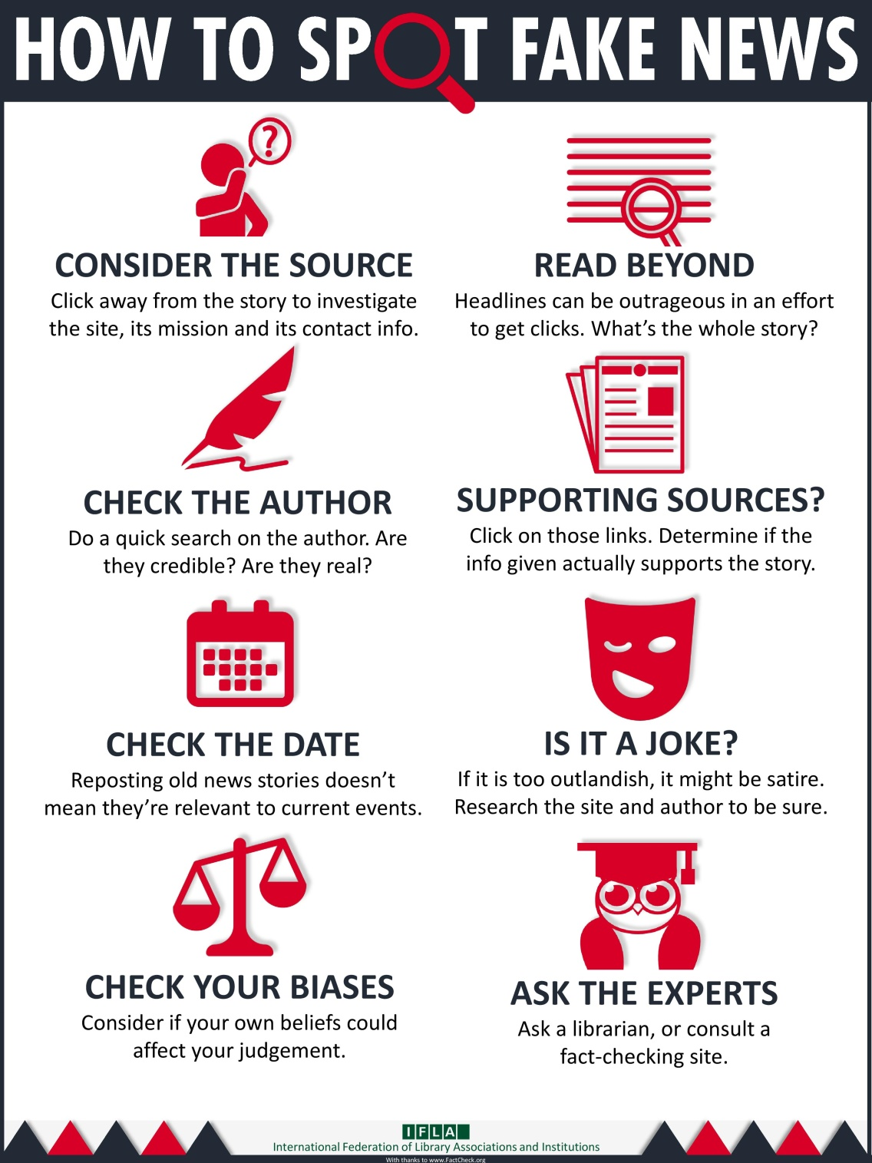
Notes:
What's wrong with fake news?
Why should you care about whether or not your news is real or fake?
You deserve the truth. You are smart enough to make up your own mind - as long as you have the real facts in front of you. You have every right to be insulted when you read fake news, because you are in essence being treated like an idiot.
Fake news destroys your credibility. If your arguments are built on bad information, it will be much more difficult for people to believe you in the future.
Fake news can hurt you, and a lot of other people. Purveyors of fake and misleading medical advice like Mercola.com and NaturalNews.com help perpetuate myths like HIV and AIDS aren't related, or that vaccines cause autism. These sites are heavily visited and their lies are dangerous.
Real news can benefit you. If you want to buy stock in a company, you want to read accurate articles about that company so you can invest wisely. If you are planning on voting in an election, you want to read as much good information on a candidate so you can vote for the person who best represents your ideas and beliefs. Fake news will not help you make money or make the world a better place, but real news can.

Slide 30
Identify the source!
Look for a byline – who wrote it?
Is this a real person? More importantly, are they credible?

Slide 31
Teaching about media literacy
Looking for sources to help students become media literate, check out the Poynter Institute’s Media Wise program: https://www.poynter.org/mediawise.
MediaWise is a nonpartisan, nonprofit initiative of The Poynter Institute that has already reached 21 million people through online educational content and fact-checking training.

Slide 32
Identify the source!
Look for a byline – who wrote it?
Is this a real person? More importantly, are they credible?
Who owns the webpage?

Slide 33
Identify the source!
Look for a byline – who wrote it?
Is this a real person? More importantly, are they credible?
Who owns the webpage?
Who originally wrote or said the information being referenced?

Slide 34
Identify the source!
Look for a byline – who wrote it?
Is this a real person? More importantly, are they credible?
Who owns the webpage?
Who originally wrote or said the information being referenced?
Who took the photo/video images?
Are they timely? Have they been changed/edited?

Slide 35
Fact Checking and Lateral Literacy
Use on-the-record interviews
Publish a list of sources with every fact-check.
Attempt to contact the person, website or organization
Emphasize primary sources and original documentation.
https://www.politifact.com/truth-o-meter/article/2018/feb/12/principles-truth-o-meter-politifacts-methodology-i/

Slide 36




Sites that get paid to do this leg work for you:
FACT CHECKING
FactCheck.org
Politifacts.com
Washington Post Fact Checker
Snopes.com
USAFacts.org (beta)
Allsides

Slide 37





FACT CHECKING - Continued
OpenSecrets.org
Poynter.org
Factitious
OpenSources.co
TinEye
SBrowning.com - WhoWhatWhen
Notes:
OpenSecrets.org - Nonpartisan, independent and nonprofit, the Center for Responsive Politics is the nation's premier research group tracking money in U.S. politics and its effect on elections and public policy.
Poynter - founded the International Fact-Checking Network in 2015 and is the leading convener, teacher and community-builder for fact-checkers around the world.
Facticious - http://factitious.augamestudio.com/#/
OpenSources.co - document created by Melissa Zimdars, assistant professor of communication and media at Merrimack College in North Andover, MA because she saw her students referencing questionable sources, she created and shared this document with them of how to think about sources, as well as a list of misleading, satirical and fake sites.
TinEye - Search by image and find where that image appears onlineSearch by image and find where that image appears online
WhoWhatWhen -WhoWhatWhen is a database of key people and events from 1000 A.D. to the present. Create graphic timelines of periods in history and of the lives of individuals. - The database consists of famous people and famous events. People entries consist of the name, short description, which category they were famous for, and birth and death dates. No detailed biographical info is in this database, but this site will provide links to popular web search engines which will give you in depth information about each person or event. While people from all over the globe are included, there is a definite "American" slant to the entries. Dates go from around 1000 AD to the present. Only people with a known year of birth and death are entered. Famous composers, scientists, political figures, writers, etc... make up most of the entries before 1900. After that, a lot of "popular culture" figures are in the database.
Nonpartisan, independent and nonprofit, the Center for Responsive Politics is the nation's premier research group tracking money in U.S. politics and its effect on elections and public policy. Nonpartisan, independent and nonprofit, the Center for Responsive Politics is the nation's premier research group tracking money in U.S. politics and its effect on elections and public policy.

Slide 38
Tampa Bay Times NIE program
Becoming an NIE teacher:
Go to tampabay.com/nie
Click Sign up here
Fill out the online request form
Logging into the electronic edition:
Go to tampabay.com/nie
Click Log in
Enter the username and password

Slide 39
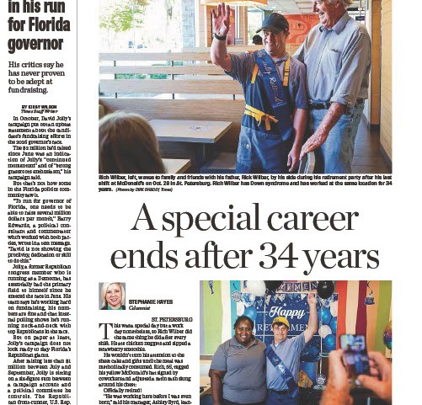

Slide 40
Jodi Pushkin, manager
jpushkin@tampabay.com
tampabay.com/nie
ordernie@tampabay.com
Facebook.com/TBTNIE
Notes:
If you need assistance with contacting a newspaper in your area, or you would like to sign up for the Times for your classroom, please contact me. Email is the best and quickest way to contact me. If I cannot help you, I will find someone who can.

