Slide 1
The life of a data journalist
Nakylah Carter - Tampa Bay Times

Slide 2
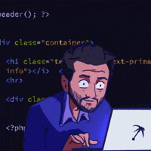
What do YOU think my job is?

Slide 3

What is a data journalist?
As many of us know, a journalist is someone who interviews people (sources) and does research to find a narrative– whether it be to explain or detail an event/phenomenon or to uncover a truth not yet reported.
Because I am a journalist I do all these things, except I get to interview some different sources: data.
What is data? Anything quantifiable. If you can ask how much? How long? How many? To what extent? What changed and how did it? That’s a data story.

Slide 4

So, because I am a journalist who later learned data reporting, when I am going through complex data, this is more what I look like…

Slide 5
Wait– how do you interview data?

Slide 6

Just how you interview people.
Data lies just as much as people do. You cannot just assume that because there is a dataset that everything is a-okay. Remember: PEOPLE MAKE THE DATASETS. People make mistakes. Data is incomplete. Sometimes it is not indicative of anything at all. Can you all think of some ways data might be wrong?

Slide 7
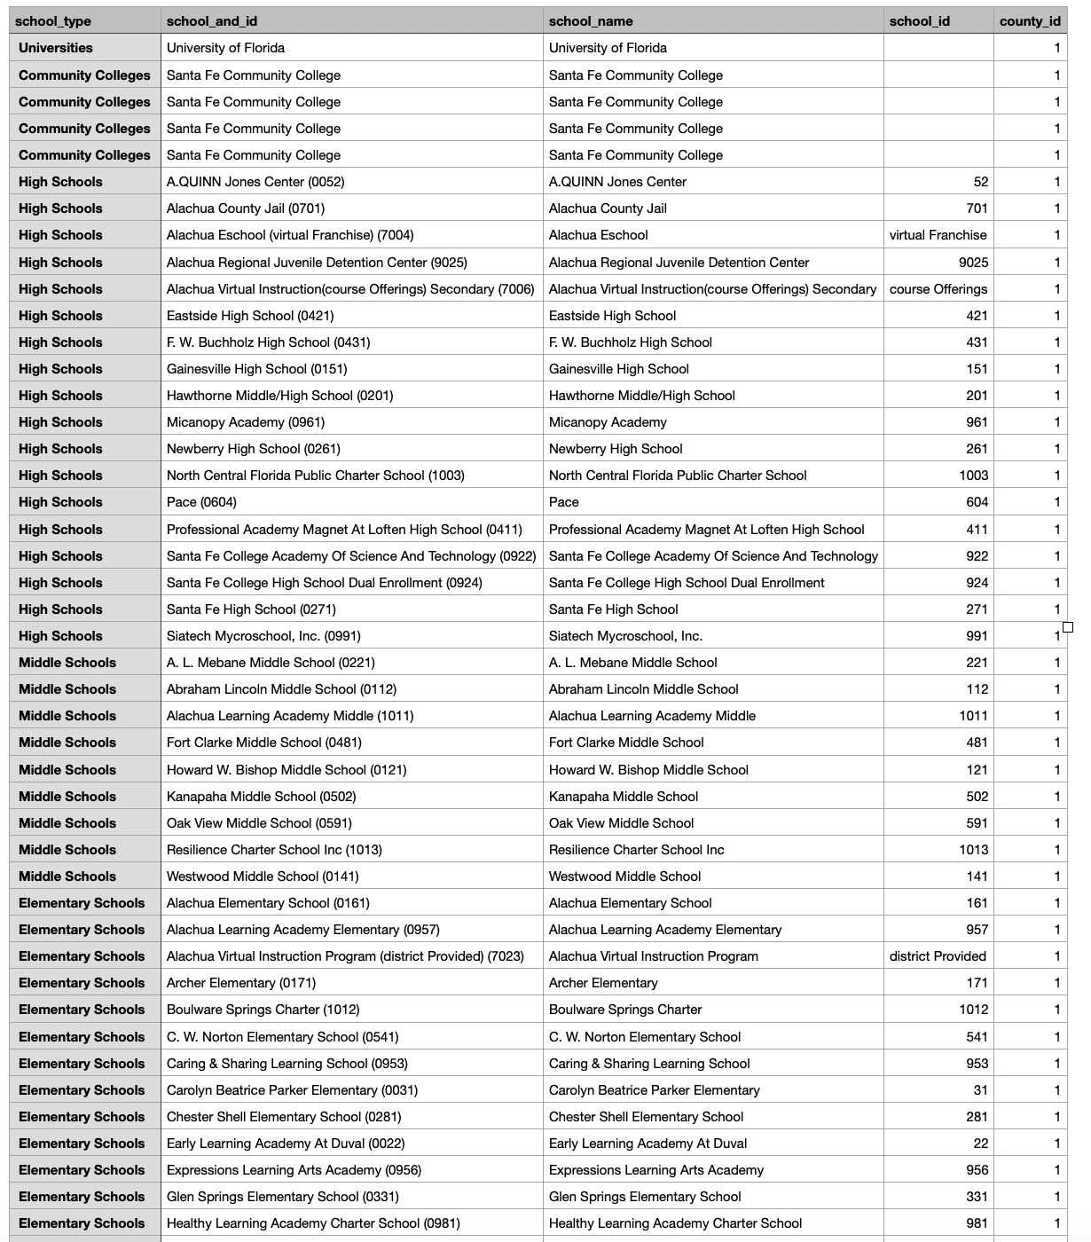
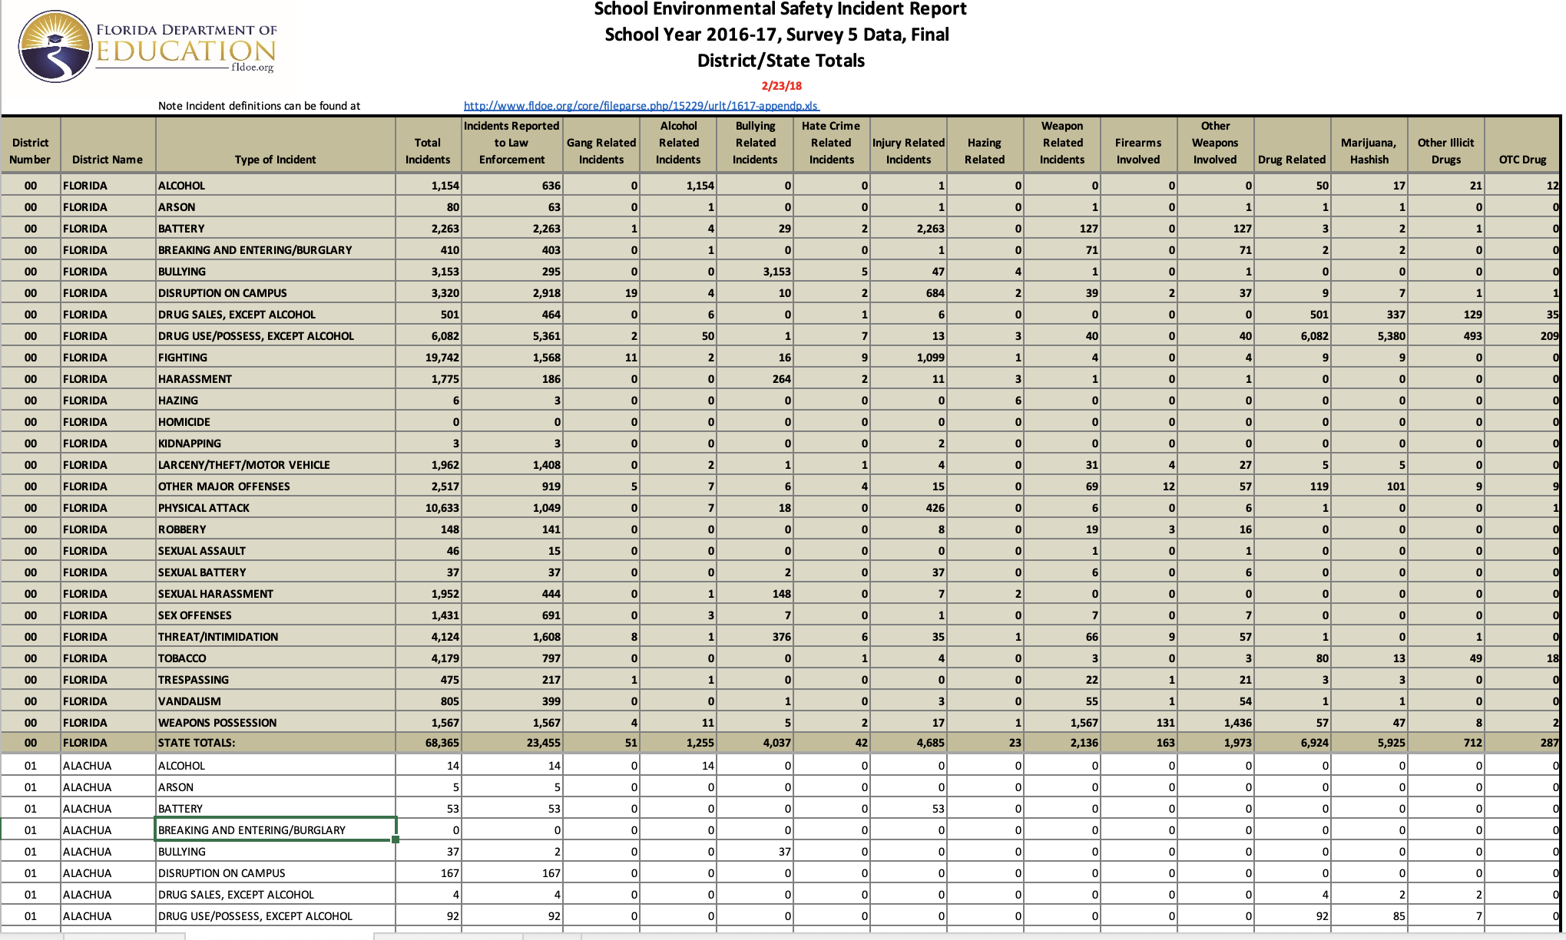
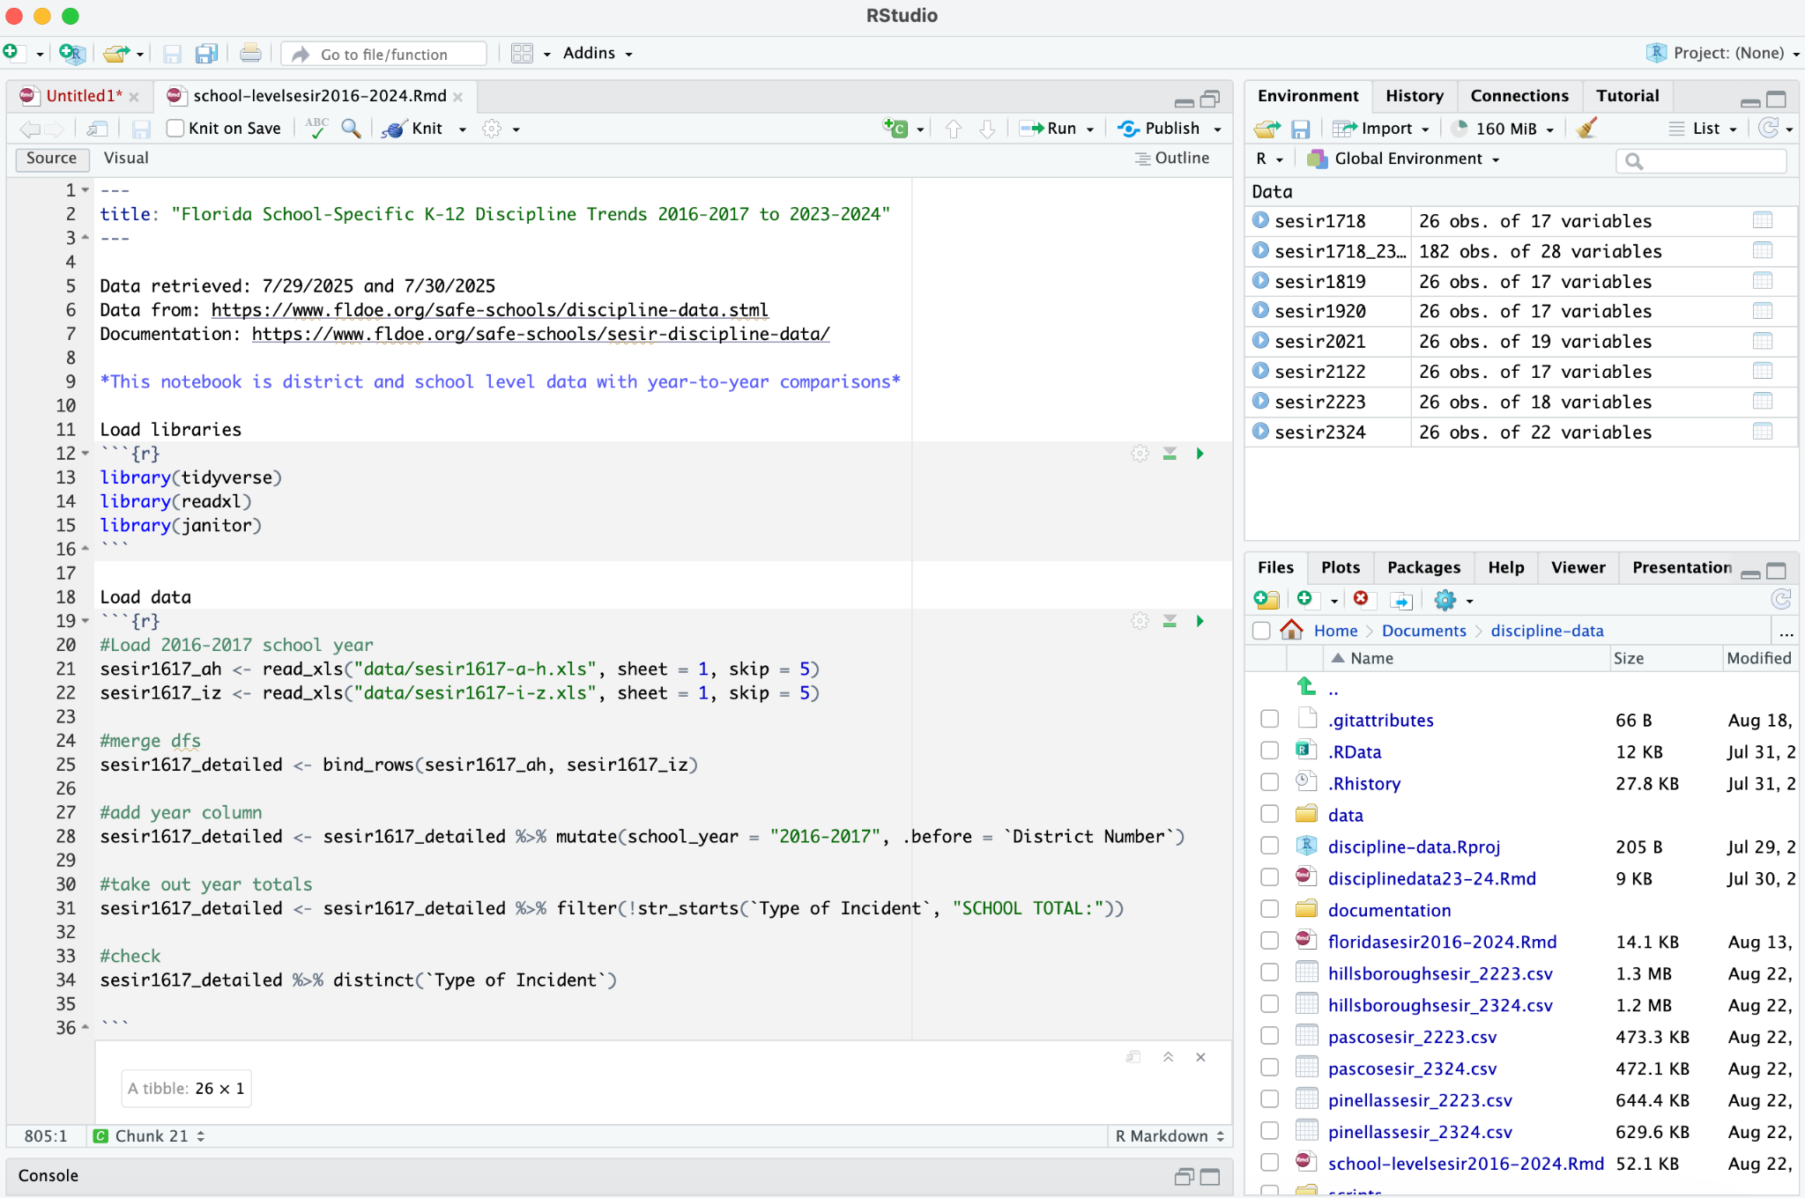
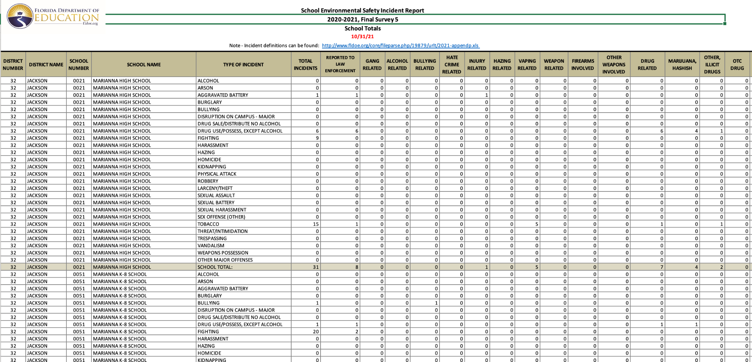
I take datasets and put them into a programming language…

Slide 8
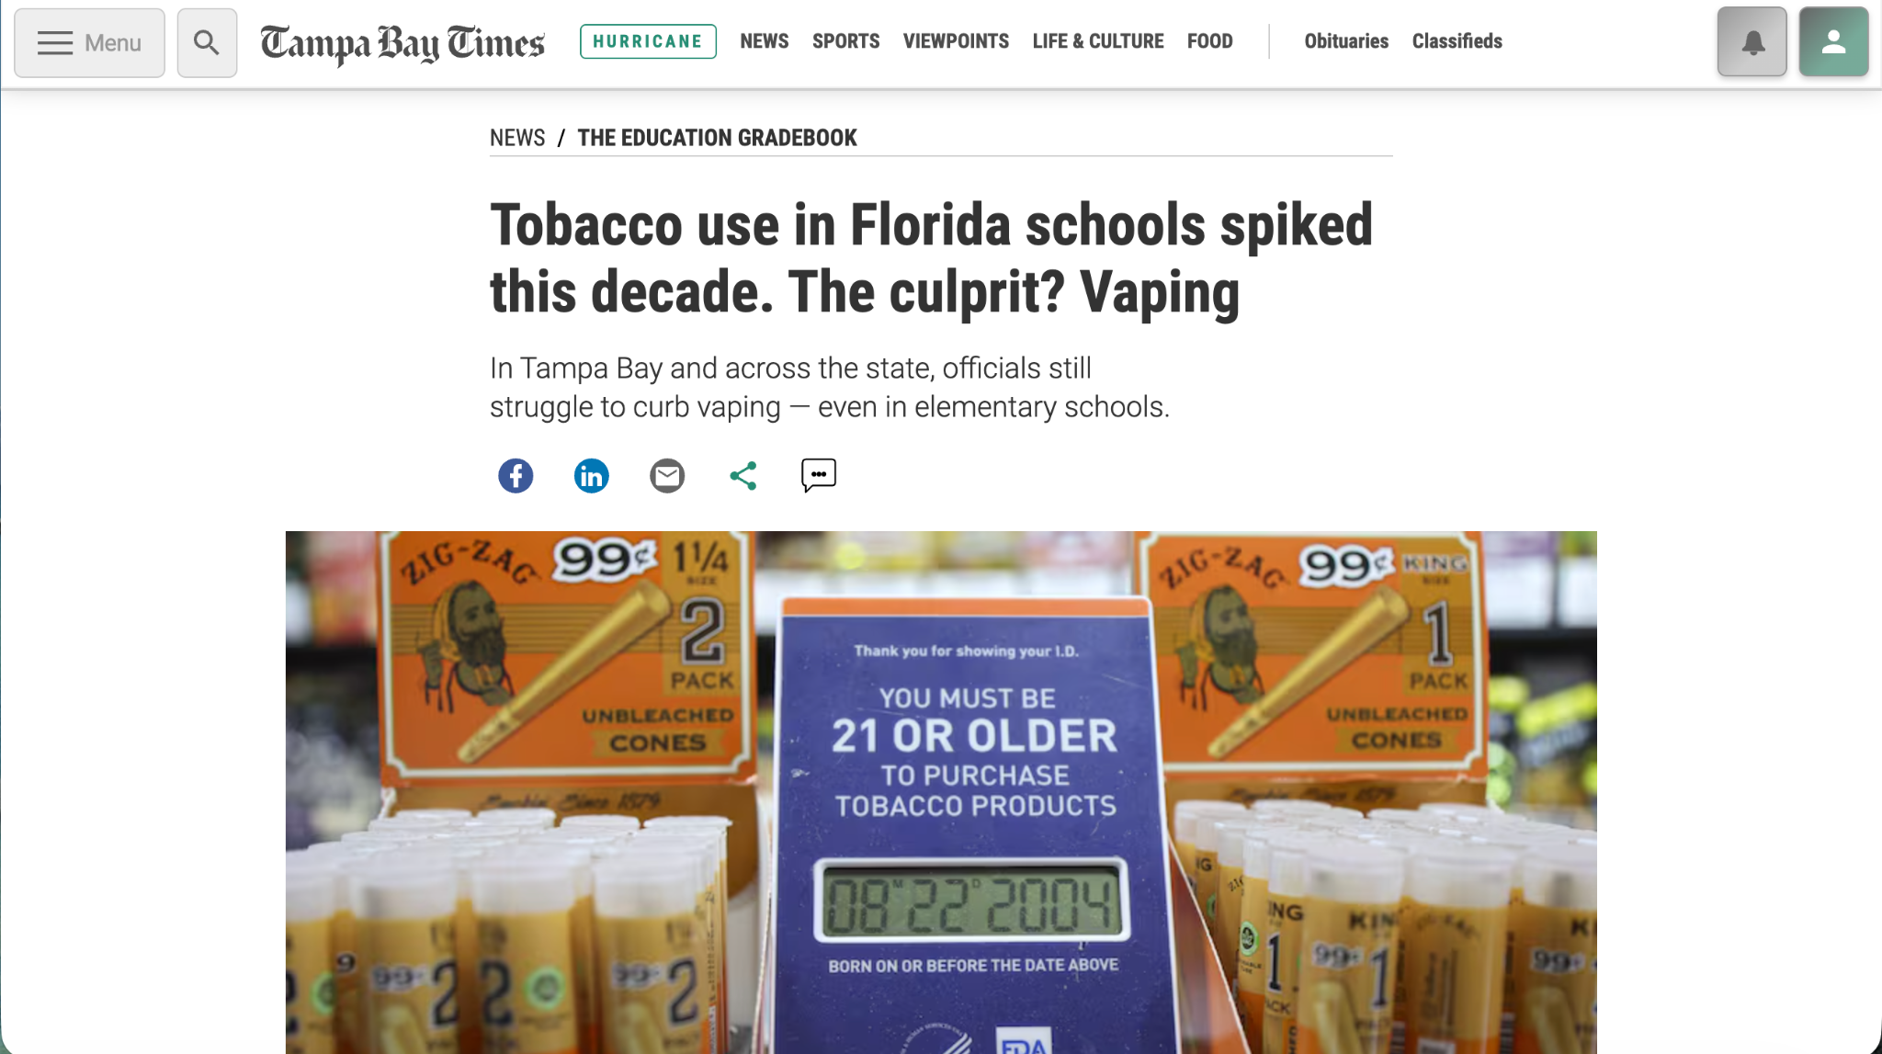
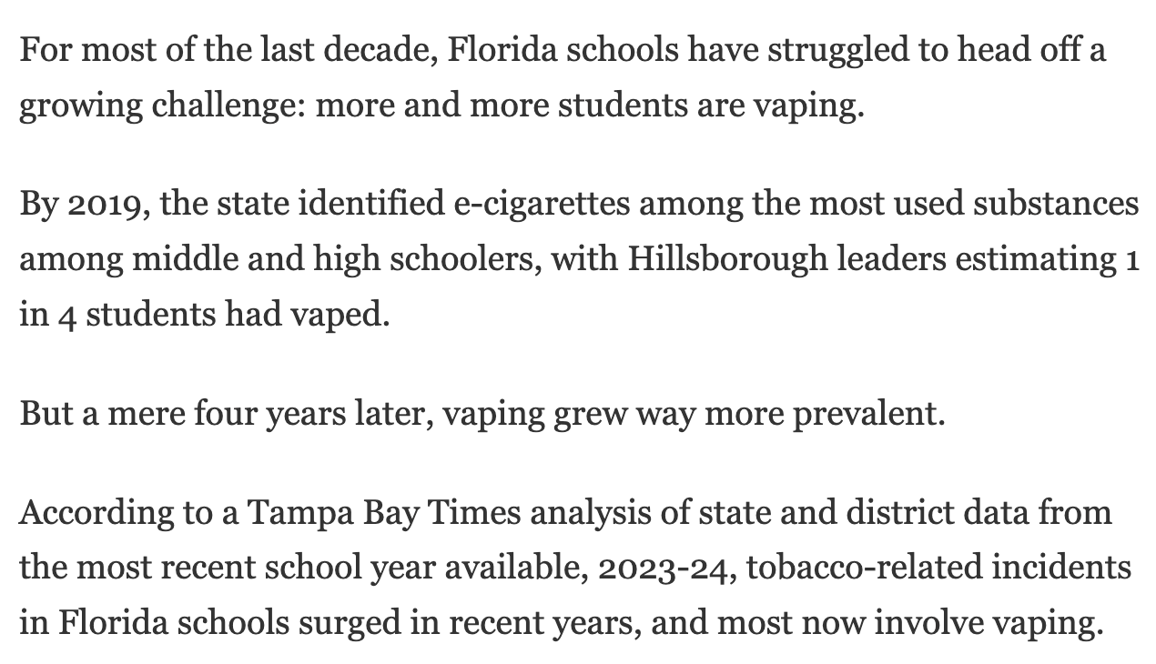
… to get something like this …

Slide 9
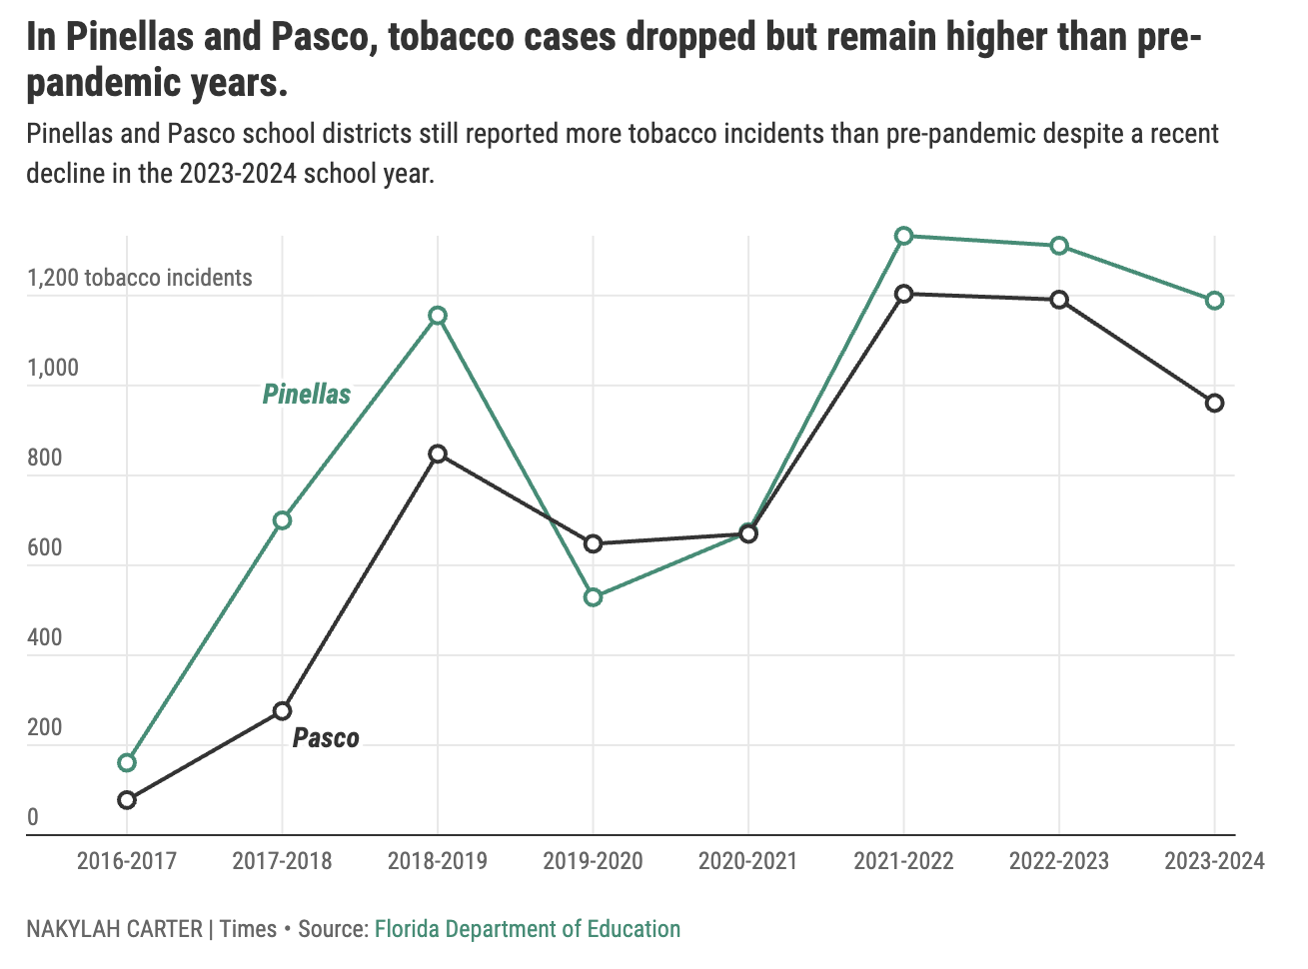
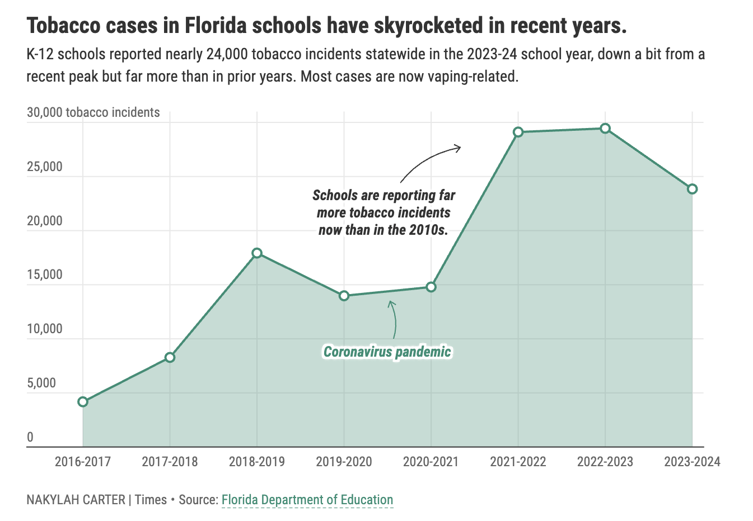
… and charts like this

Slide 10
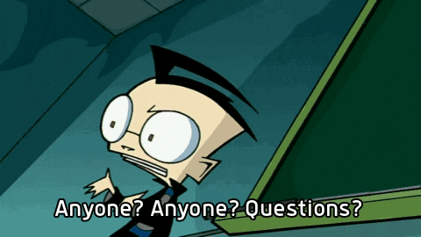
Questions?

Slide 11
Thanks!
Do you have any questions?
ncarter@tampabay.com
tampabay.com
Please keep this slide for attribution

